Slide 1
April 10, 2023
Board of Commissioners Meeting | Draft Plan

Slide 2
The Master Plan Process
Brookline Park Master Plan

Slide 3
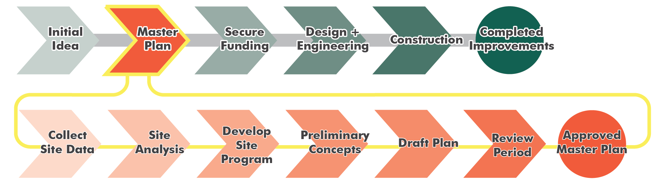
What is a Master Plan?
We are Here
“All voices are heard and all ideas are honored”
Transparent Public Outreach Process:
4 Public Meetings
6 Steering Committee Meetings
4 Focus Group Meetings
2 BOC Meetings
Web-based Public Opinion Survey
2-Month Draft Plan Review Period
Total Public Access to the SC Team During the Master Plan Process

Slide 4
Project Schedule
BROOKLINE PARK MEETINGS | PURPOSE | DATE | TIME
Steering Committee Meeting 1 | Project review, protocols | Wed, Sep 28, 2022 | 7:00 PM - 8:30 PM
Steering Committee Meeting 2 | Site Visit / Brainstorming | Wed, Oct 19, 2022 | 5:00 PM – 7:00 PM
Public Meeting 1 | Brainstorming | Mon, Oct 24, 2022 | 7:00 PM - 9:00 PM
Focus Group Meeting 1 | Moms Group | Wed, Nov 9, 2022 | 3:00 PM - 4:00 PM
Focus Group Meeting 2 | Neighbors | Thur, Nov 10, 2022 | 7:30 PM - 8:30 PM
Focus Group Meeting 3 | Middle School Students | Fri, Nov 11, 2022 | 9:00 AM – 10:00 AM
Focus Group Meeting 4 | Penfield Civic | Wed, Nov 16, 2022 | 5:30 - 6:30 PM
Focus Group Meeting 5 | Senior Citizens | TBD | TBD
Steering Committee Meeting 3 | Initial Concepts | Wed, Nov 16, 2022 | 7:00 PM - 8:30 PM
Public Meeting 2 | Initial Concepts | Tues, Dec 6, 2022 | 7:00 – 9:00 PM
Steering Committee Meeting 4 | Concepts Refinement | Tues, Jan 24, 2023 | 7:00 PM - 8:30 PM
Steering Committee Meeting 5 | Pre-Draft Master Plan | Tues, Mar 7, 2023 | 7:00 PM - 8:30 PM
Public Meeting 3 | Draft Master Plan | Wed, Mar 29, 2023 | 7:00 - 9:00 PM
Board of Commissioners Meeting 1 | Draft Master Plan | Mon, April 10, 2023
Steering Committee Meeting 6 | Review Draft Plan | Tue, June 6, 2023 | 7:00 PM - 8:30 PM
Public Meeting 4 | Final Master Plan | Thu, June 29, 2023 | 7:00 PM - 9:00 PM
Board of Commissioners Meeting 2 | Final Master Plan | Mon, July 10, 2023

Slide 5
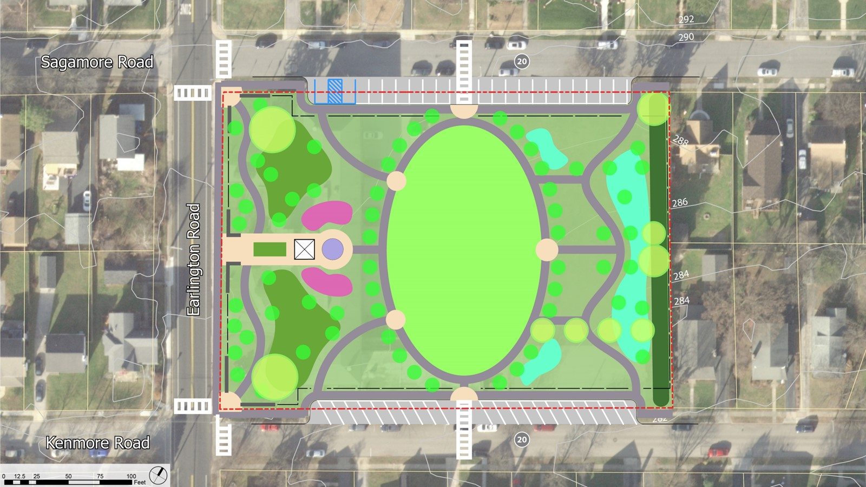
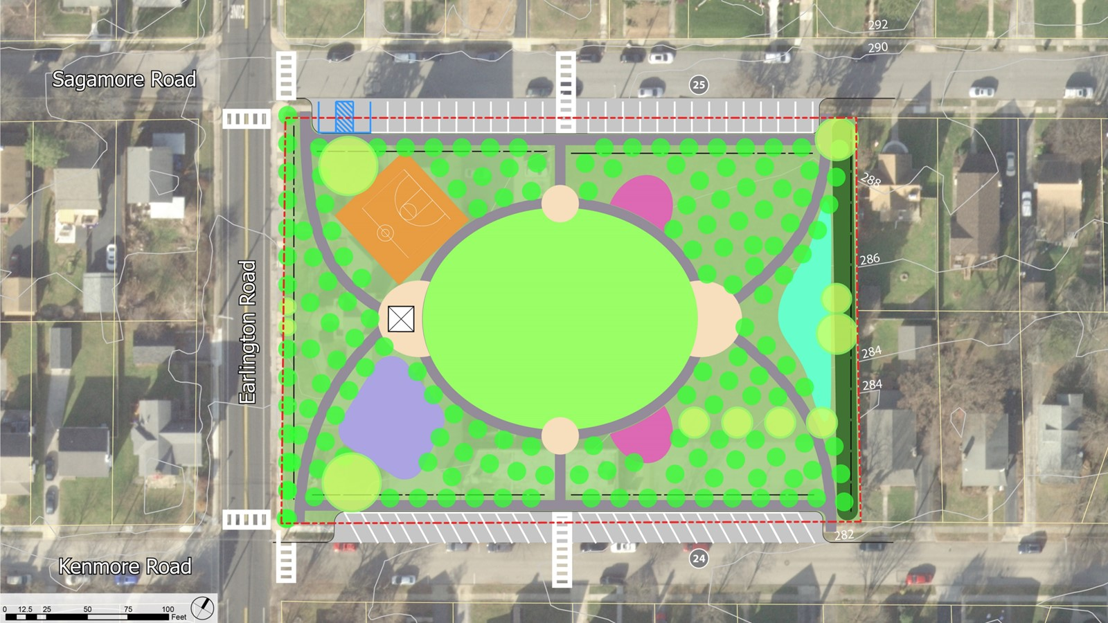
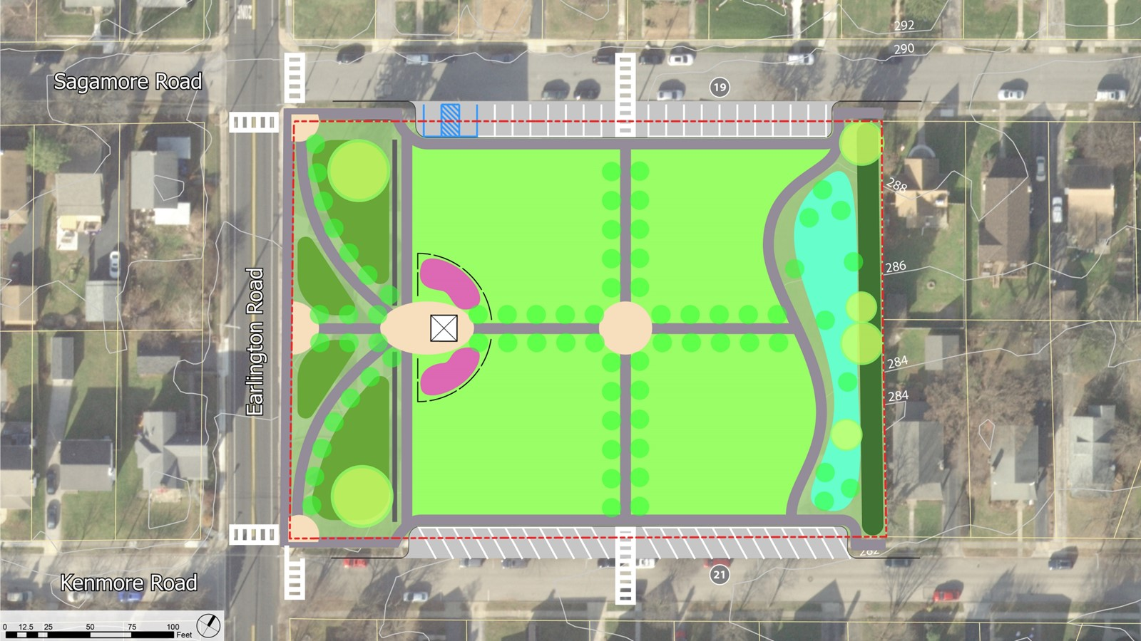
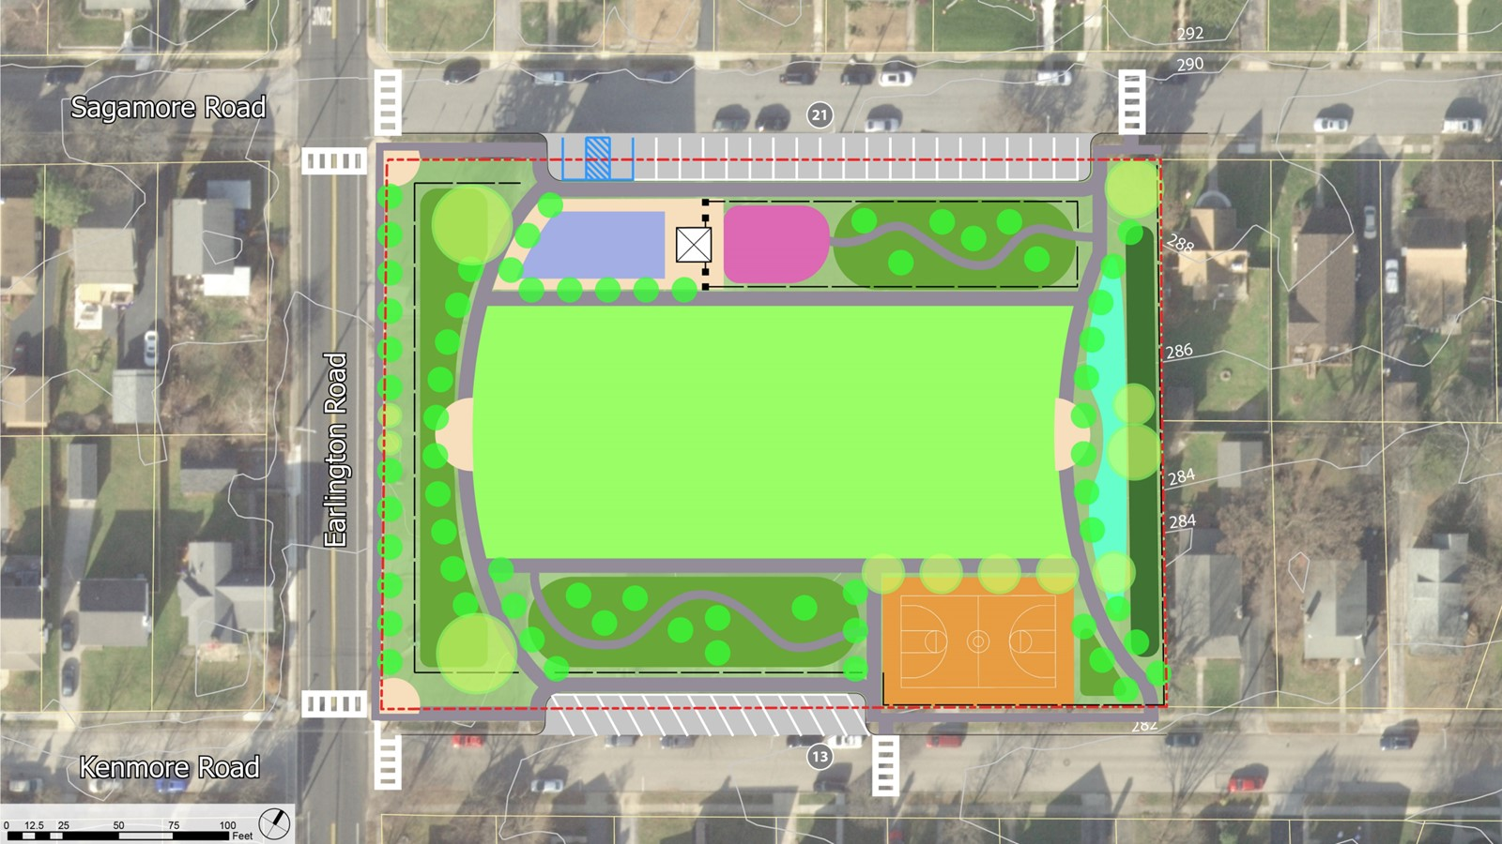
PUBLIC INPUT UPDATE
1047 INTERACTIONS
Public Meeting 1
Oct 24, 2022
Brainstorming & Programming
82 attendees
77 Ideas Shared
4 Focus Groups
  Young Families Group – 13 attendees
  Adjacent Neighbors – 15 attendees
  Middle School Students – 10 attendees
  Senior Citizens – 4 attendees
Public Survey
879 Responses
Public Meeting 2
Dec 6, 2022
Concept Studies
33 Attendees
11 Follow up letters
  From adjacent neighbors
  Concerns with parking & restrooms
  Some support for angle Parking
5

Slide 6
Program Refinement
Brookline Park Master Plan

Slide 7
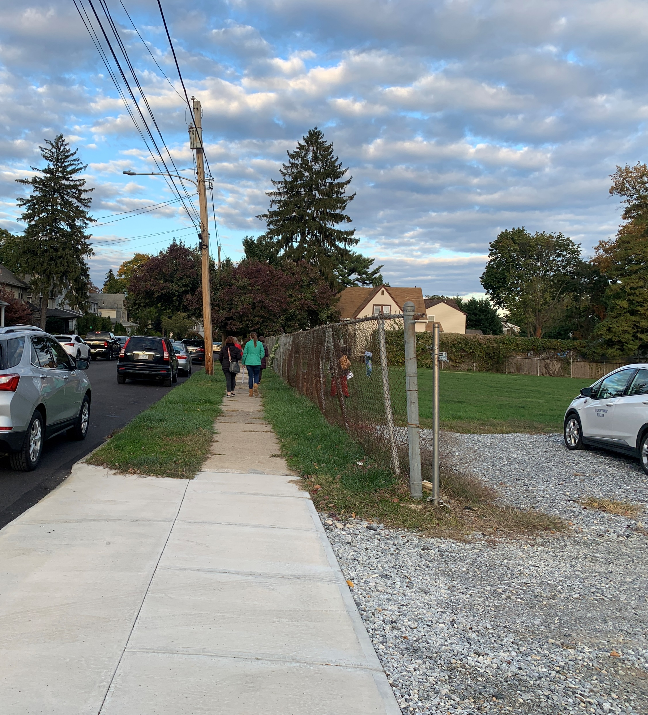
Program Elements
Open lawn for gathering and play
Small plaza
Seating / gathering areas of various scale
Shade Structure / Trees
Court games
Playground
Lighting
Decision Points
Water Play Feature (Splash Pad)
Restroom
Parking

Slide 8
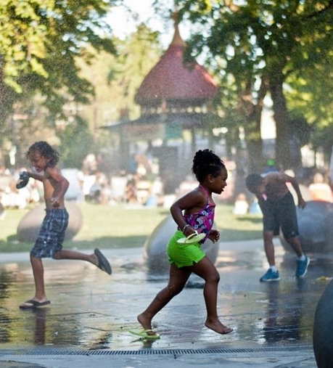
Water Play Feature
Removed from Park Program
  Neighborhood concerns regarding a destination facility
  Recreation, Parks and Open Space Study identifying other preferred locations.

Slide 9
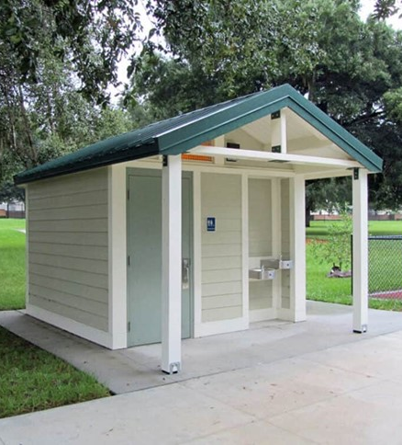
Restroom
Strong options for and against restrooms throughout the process.
Survey Respondents in favor of Restrooms sorted by Distance from Park :
    1/8 mile 27 % (44 of 163)
    1/4 mile 53 % (69 of 131)
    1/2 mile 60 % (91 of 152) walking distance
    >1 mile 65 % (177 of 271)
    All 53 % (382 of 717)
Main concerns expressed by neighbors is maintenance
Plan recommends:
  Single Occupancy Building w/ Drinking Fountain
  Vandal Resistance Finishes / Automatic Nighttime locks
  Building finishes should draw from the neighborhood’s residential architectural style

Slide 10
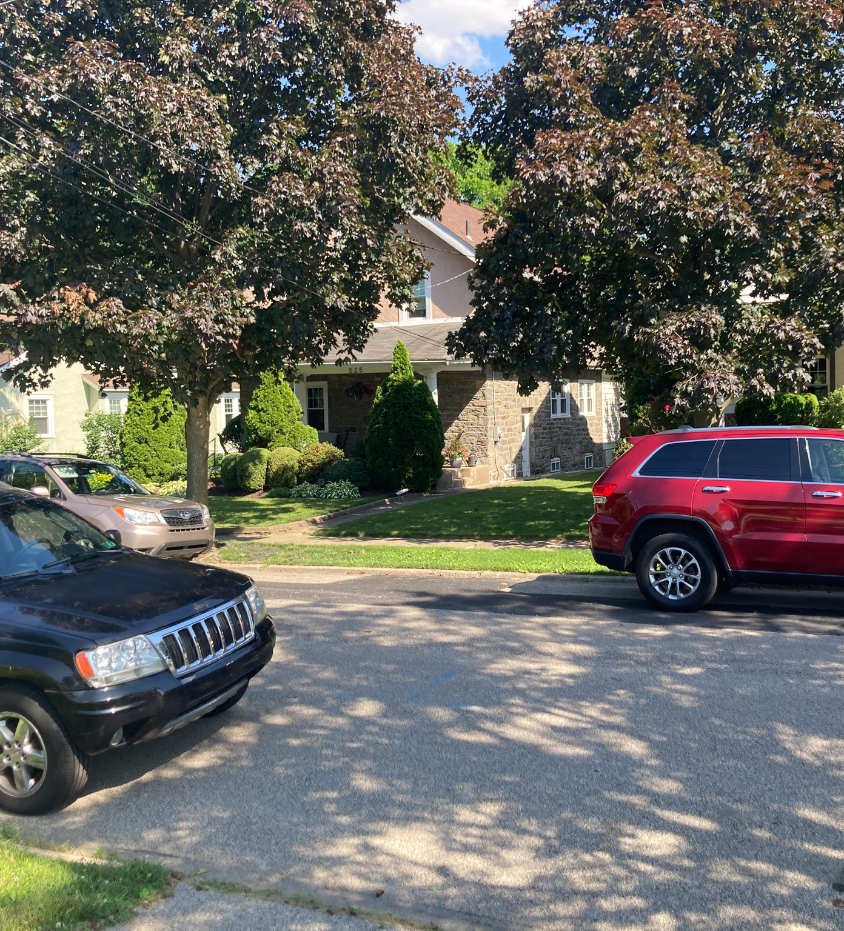
Parking
Township zoning officer determined that additional parking is required for a new park.
Goals for parking
  Develop a concept that provides space for both the neighborhood and park users
  Maximize Park green space
  Minimize pedestrian / vehicular conflicts
  Provide adequate parking while minimizing additional pavement

Slide 11
Draft Plan
Brookline Park Master Plan

Slide 12
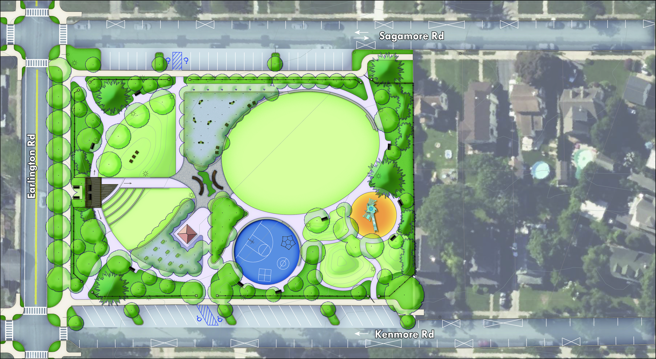
1
4
9
1
2
6
11
8
Major Area Key
1
Earlington Road Streetscape
Park Porch
Central Gathering
Eastern Play
Parking (83 Total)
1
2
2
3
3
4
4
#
5
7
9
6
4
3
6
1

Slide 13
Earlington Road streetscape improvements focus on creating a safe pedestrian environment for people walking to or past the park.
F
Earlington Road Streetscape Key
E
A
8 ft-wide Verge with Shade Trees
8 ft-wide Sidewalk
Seating Plaza & Feature Wall
Fence Line within Planting Bed
Park Entrance
Curb Extension, Crosswalks & Rapid Flashing Beacon
D
B
C
C
D
F
B
E
F
A
E
A
E
D
B
F
13

Slide 14
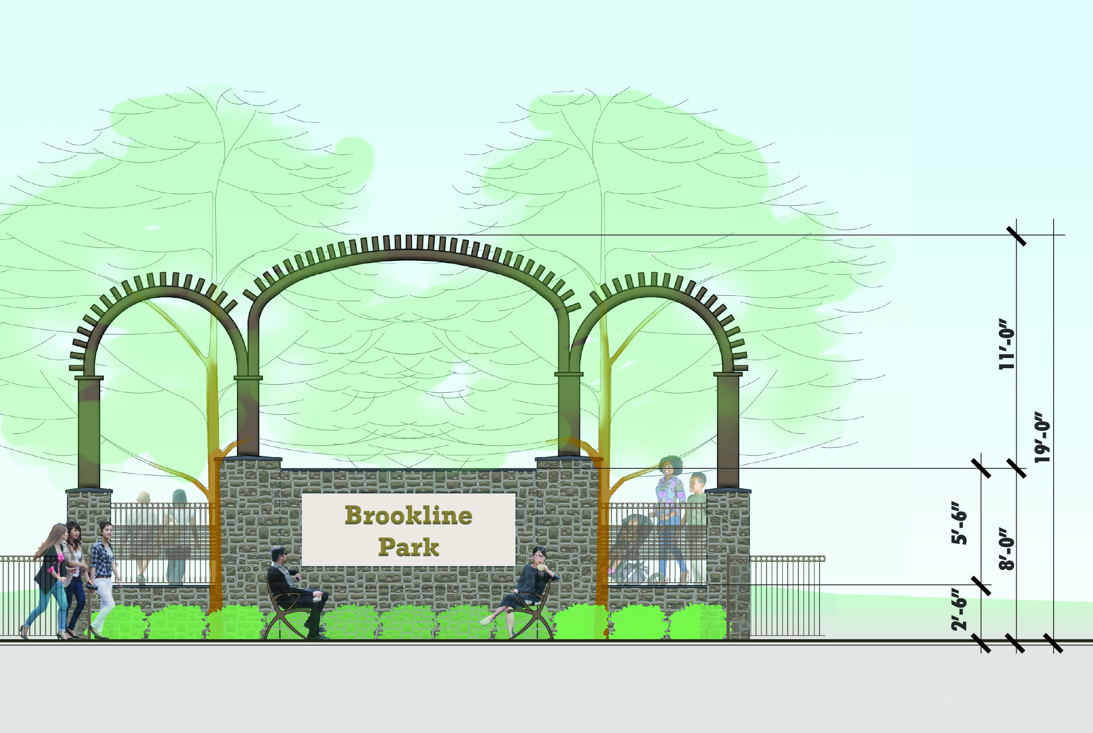
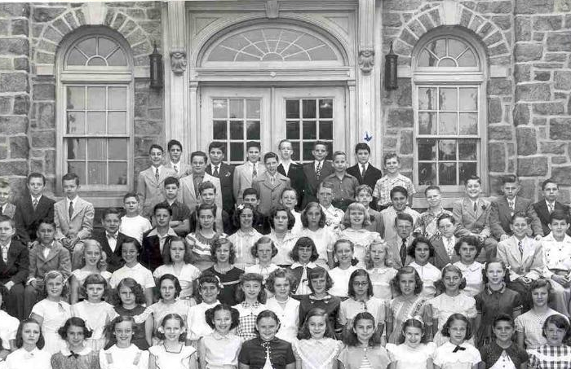
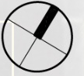
Seating Plaza & Feature Wall
Elevation concept
Design incorporate features from school façade.
Reuse salvaged stone from building
Historic image of Brookline School entry façade depicting the arch motif.
Elevation of Feature Wall viewed from Earlington Road

Slide 15
J
The Porch serve as a transition space from the Earlington Streetscape into the entire of the Park. It is a place to sit and watch and to be seen.
F
H
The Porch Key
F
D
A
Elevated Plaza with Trellis
Bench Swing (2)
Lawn Steps
Large Lawn Mound
Movable Adirondack Style Chairs
Tradition Bench
Open Lawn
Mix border / bed planting
Fence 4ft-Tall
Stone Piers at Park Entrance
E
B
C
A
D
B
E
C
F
G
G
H
H
I
I
J
J

Slide 16
K
J
The Central Gathering Area is comprised of three seating areas and defined by a generous central spine pathway that connects Sagamore Road to Kenmore Road
A
The Central Gathering Area Key
B
C
A
Tree grove w/ stone dust paving
Movable bistro chairs & tables (5)
Movable Adirondack style chairs (5)
Central plaza
Modern conversation bench (2)
Tree grove in planting bed
Single occupancy restroom
Boulder seating (8)
Mix border / planting bed
Fence 4ft-tall
Stone piers at park entrance
B
D
C
E
D
E
F
F
G
G
H
H
I
A
J
K
I
J
K

Slide 17
H
The Eastern Play Area focuses young kid activities in the interior of the park away from Earlington Road while still being close to key park amenities.
I
B
Eastern Play Area Key
G
A
A
Open lawn
Seat wall
Playground
Small lawn play mounds (3)
Game court
Seat wall
Mix border / planting bed
Buffer planting
Fence 4ft-tall
Stone piers with gate at park entrance
Fence 6ft-tall
B
J
C
D
E
F
E
C
G
G
H
I
D
C
C
J
F
I
H

Slide 18
Lighting Concept
Schematic layout for budgetary purposes
Design provides lighting along walkways

Slide 19
Funding & Probable Cost of Development
Brookline Park Master Plan

Slide 20
Probable Cost of Development
Local Funding
    Delaware County
    Township Parks Capital Improvement Funds
State Funding
    DCNR – C2P2
    DCED – GTRP
    CDBG – Sidewalk Improvements
    Land & Water Conservation Fund (Federal through DCNR)

Slide 21
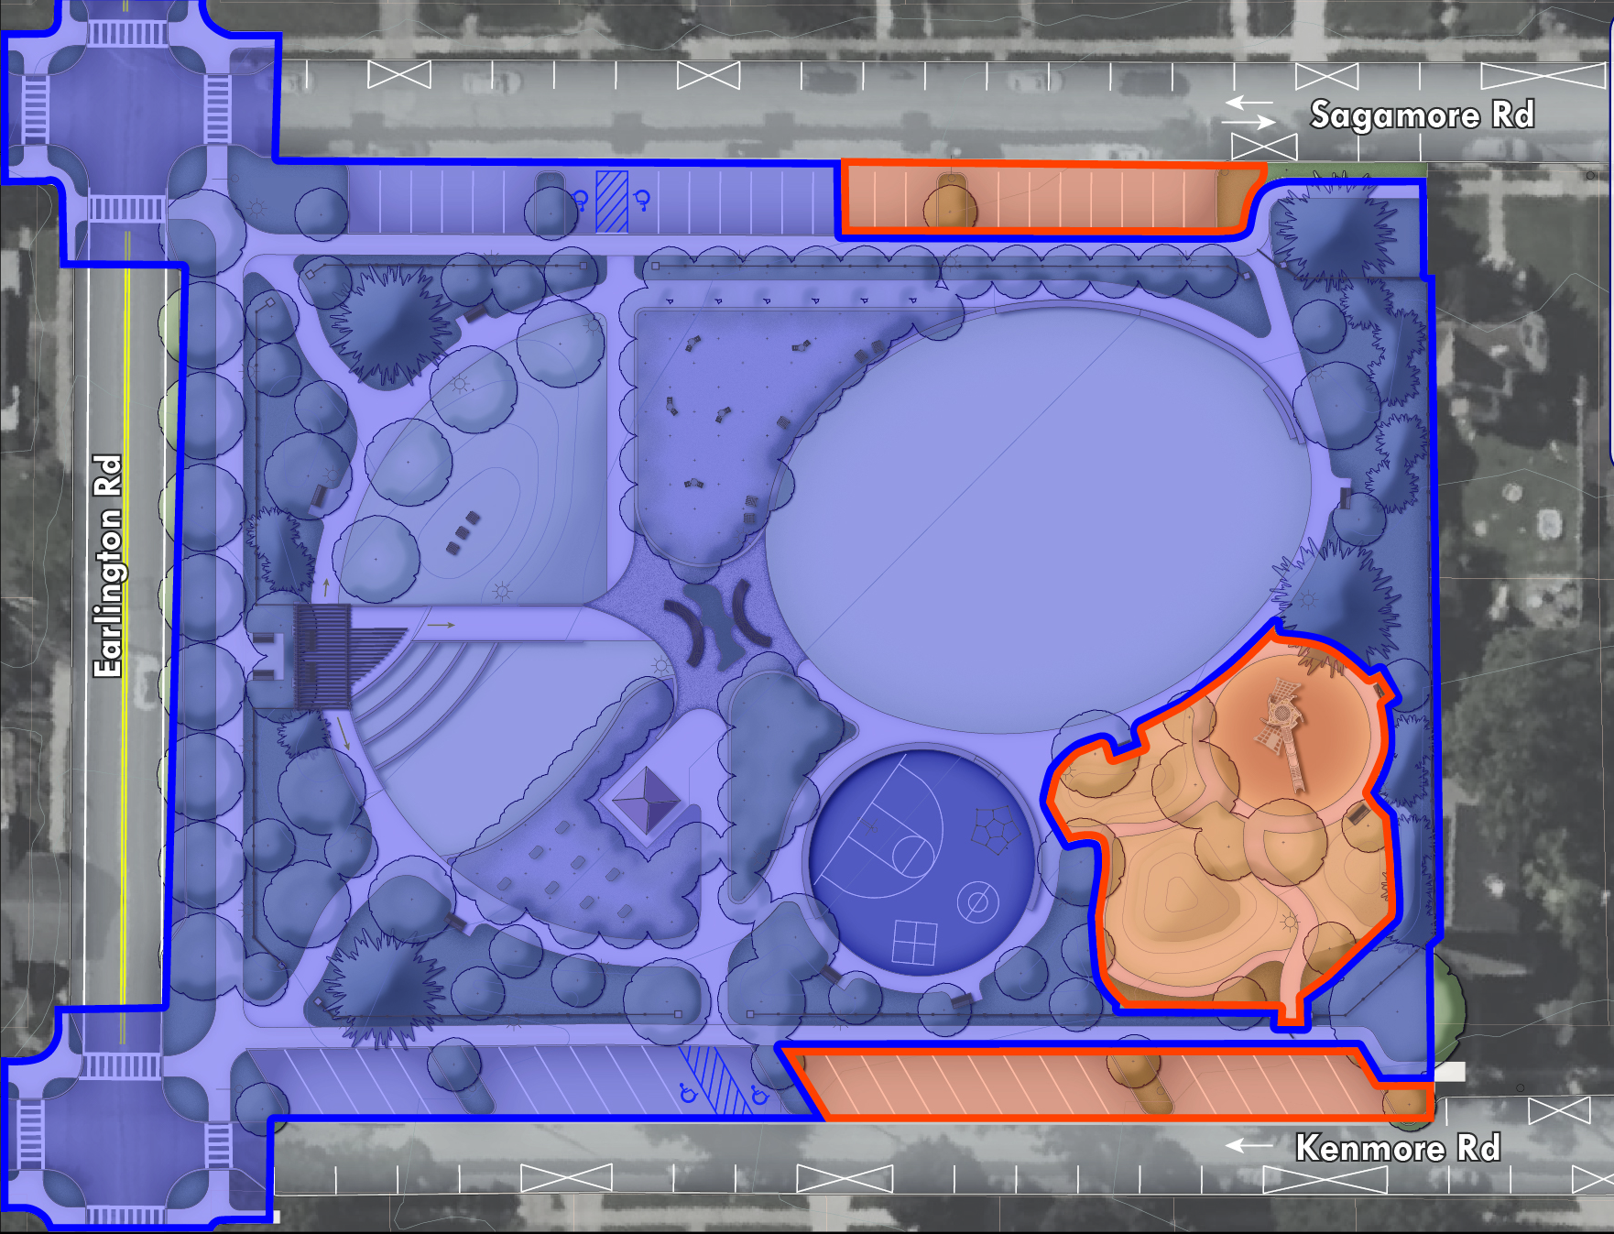
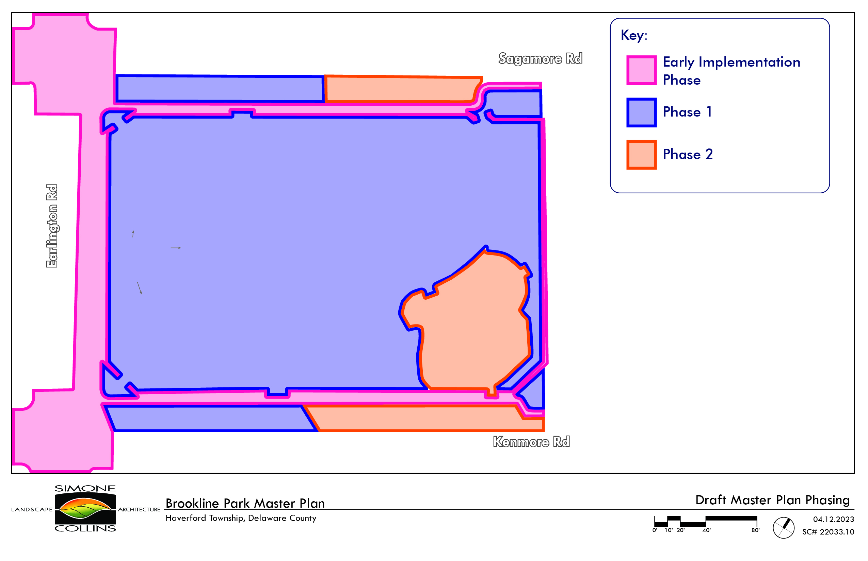
Probable Cost of Development

Slide 22
Questions & Comments
Brookline Park Master Plan

Slide 23
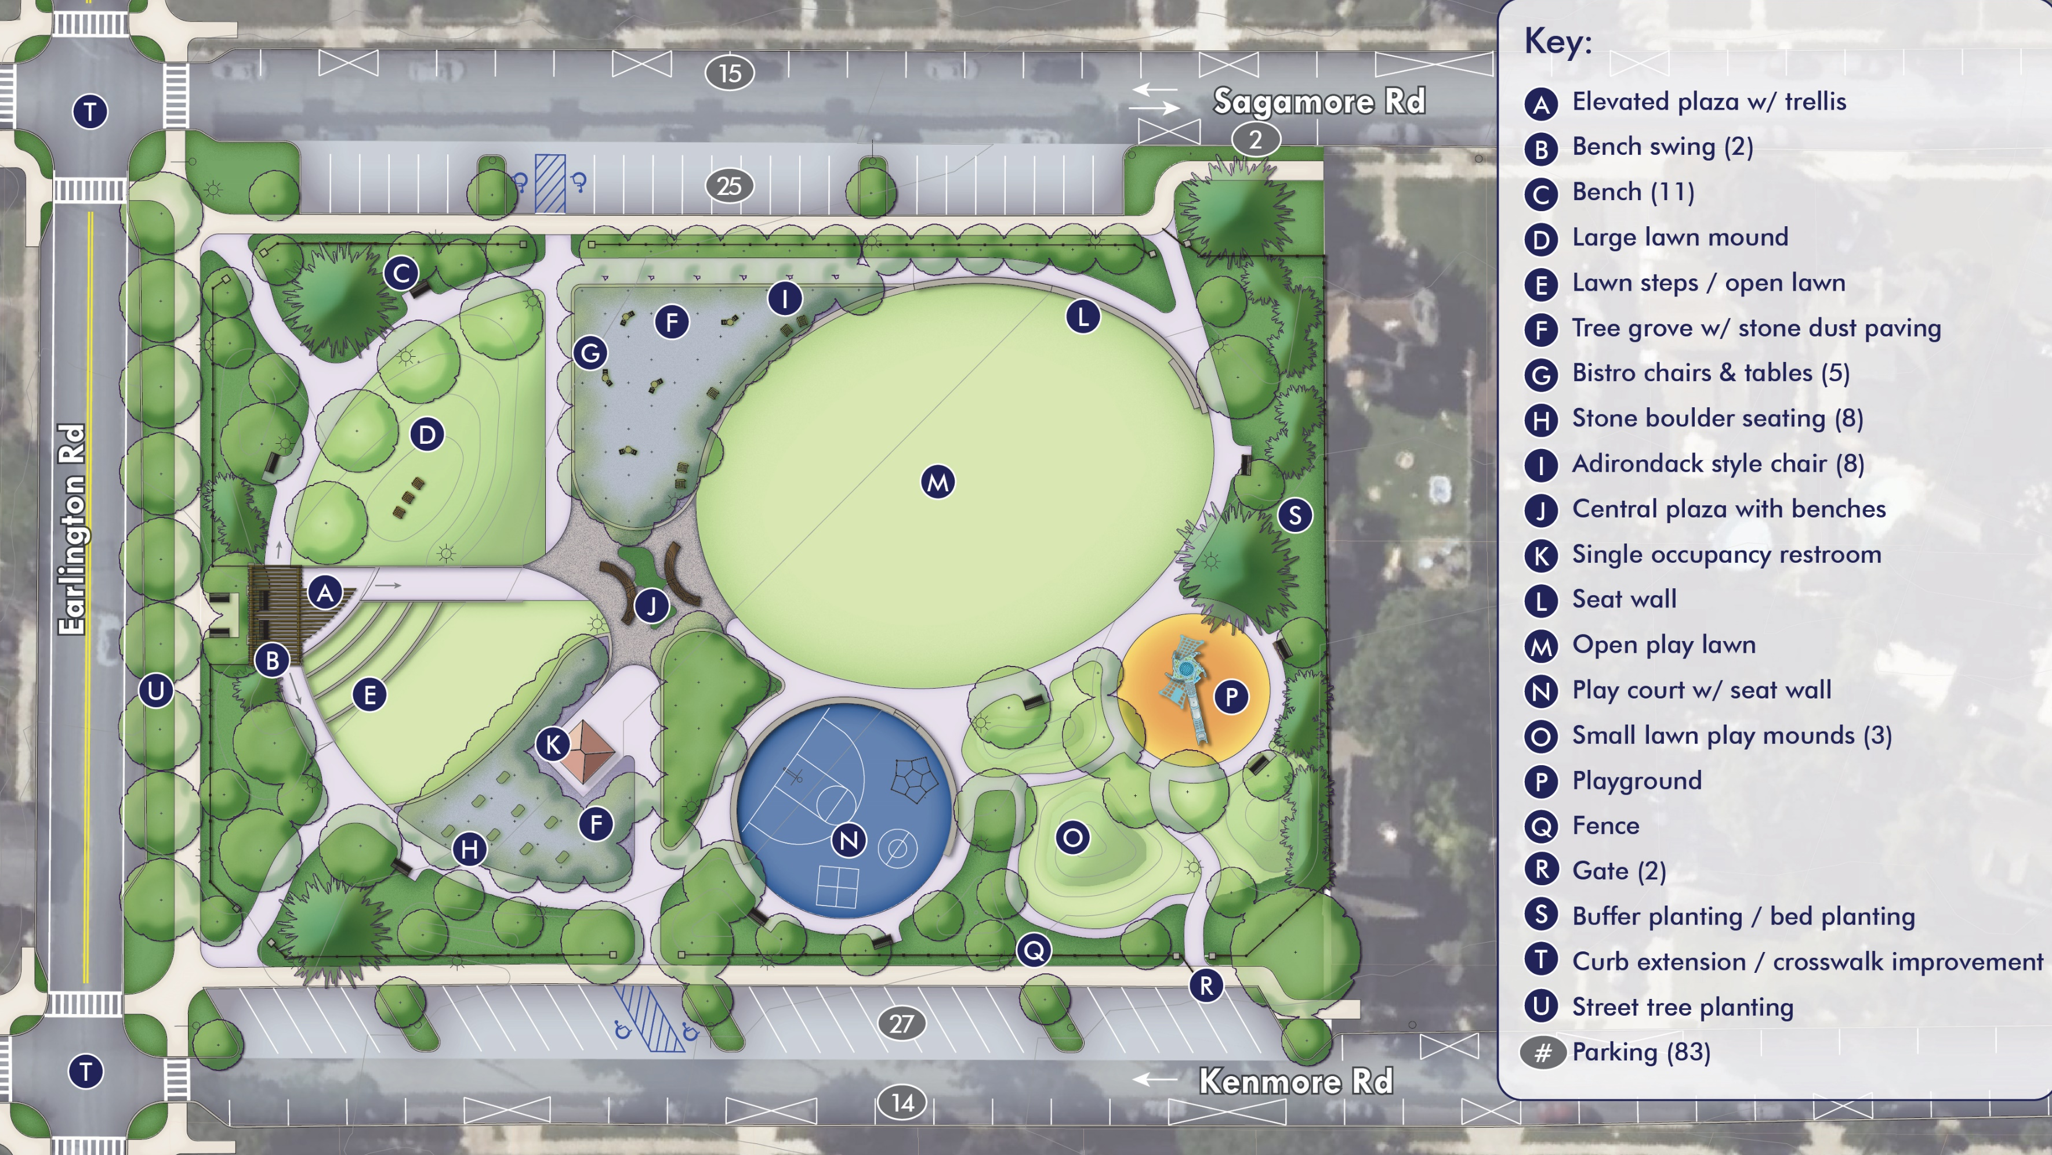

Slide 24
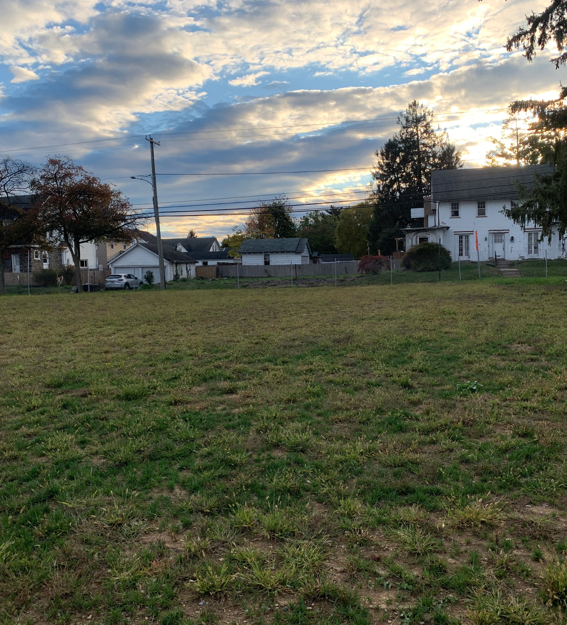
Thank you!
Simone Collins Landscape Architecture
Peter Simone, RLA, FASLA, Principal
psimone@simonecollins.com
Sarah Leeper, RLA, Project Manager
sleeper@simonecollins.com
Michelle Armour, Staff Landscape Architect
marmour@simonecollins.com

Slide 25
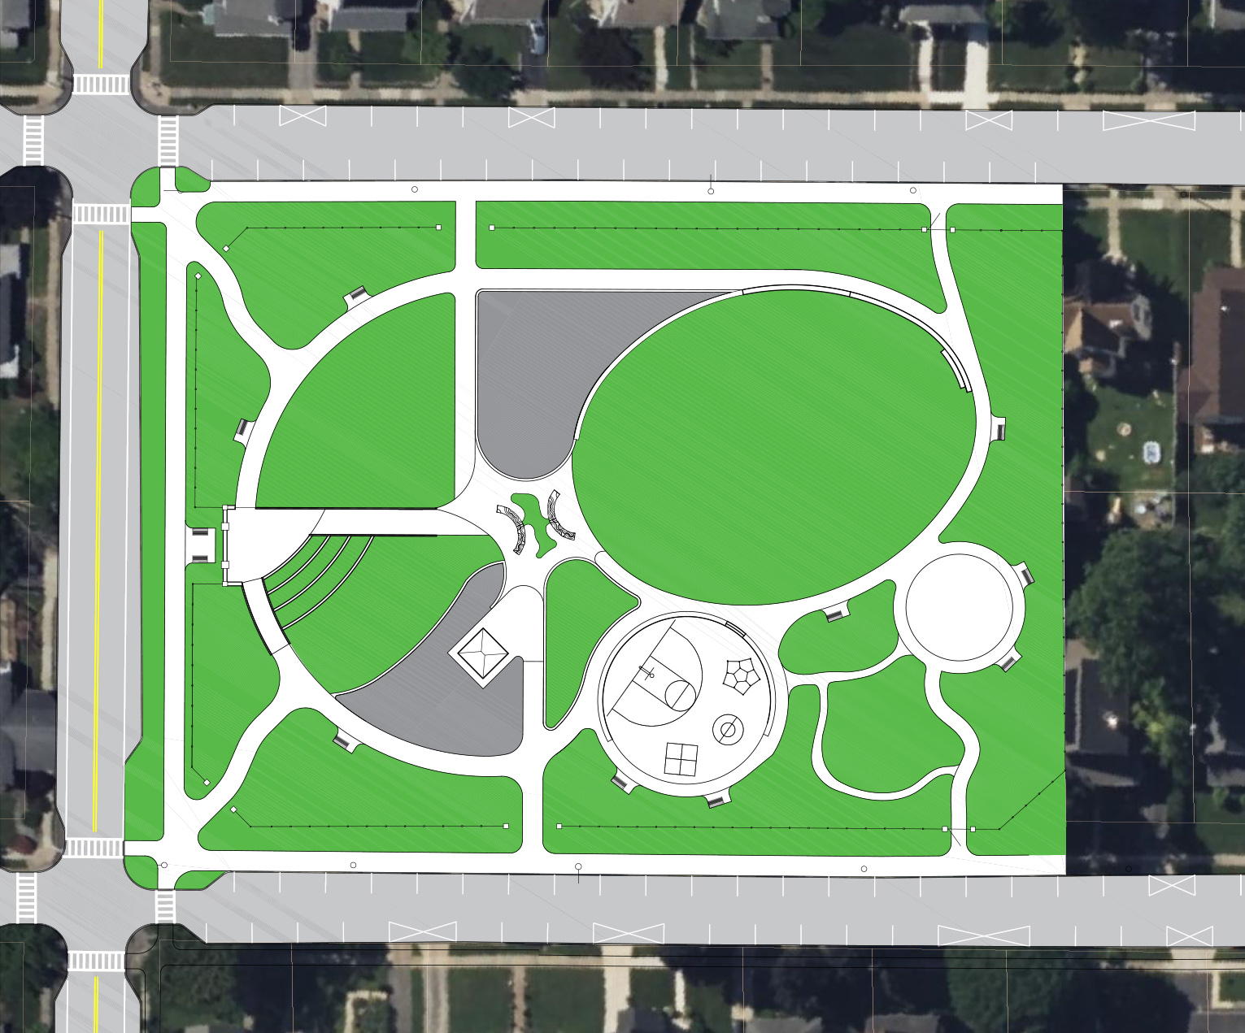
Parking – Existing Conditions
    Sagamore along Park 18 Spaces
    Kenmore along Park 18 Spaces
    Total Spaces along Park 36 Spaces
    Sagamore Opposite Park 15 Spaces
    Kenmore Opposite Park 14 Spaces
    Total Spaces Opposite Park 29 Spaces
    Total Existing On-street 65 Spaces Spaces within the
    Park Vicinity
Sagamore Rd
Earlington Rd
Kenmore Rd

Slide 26
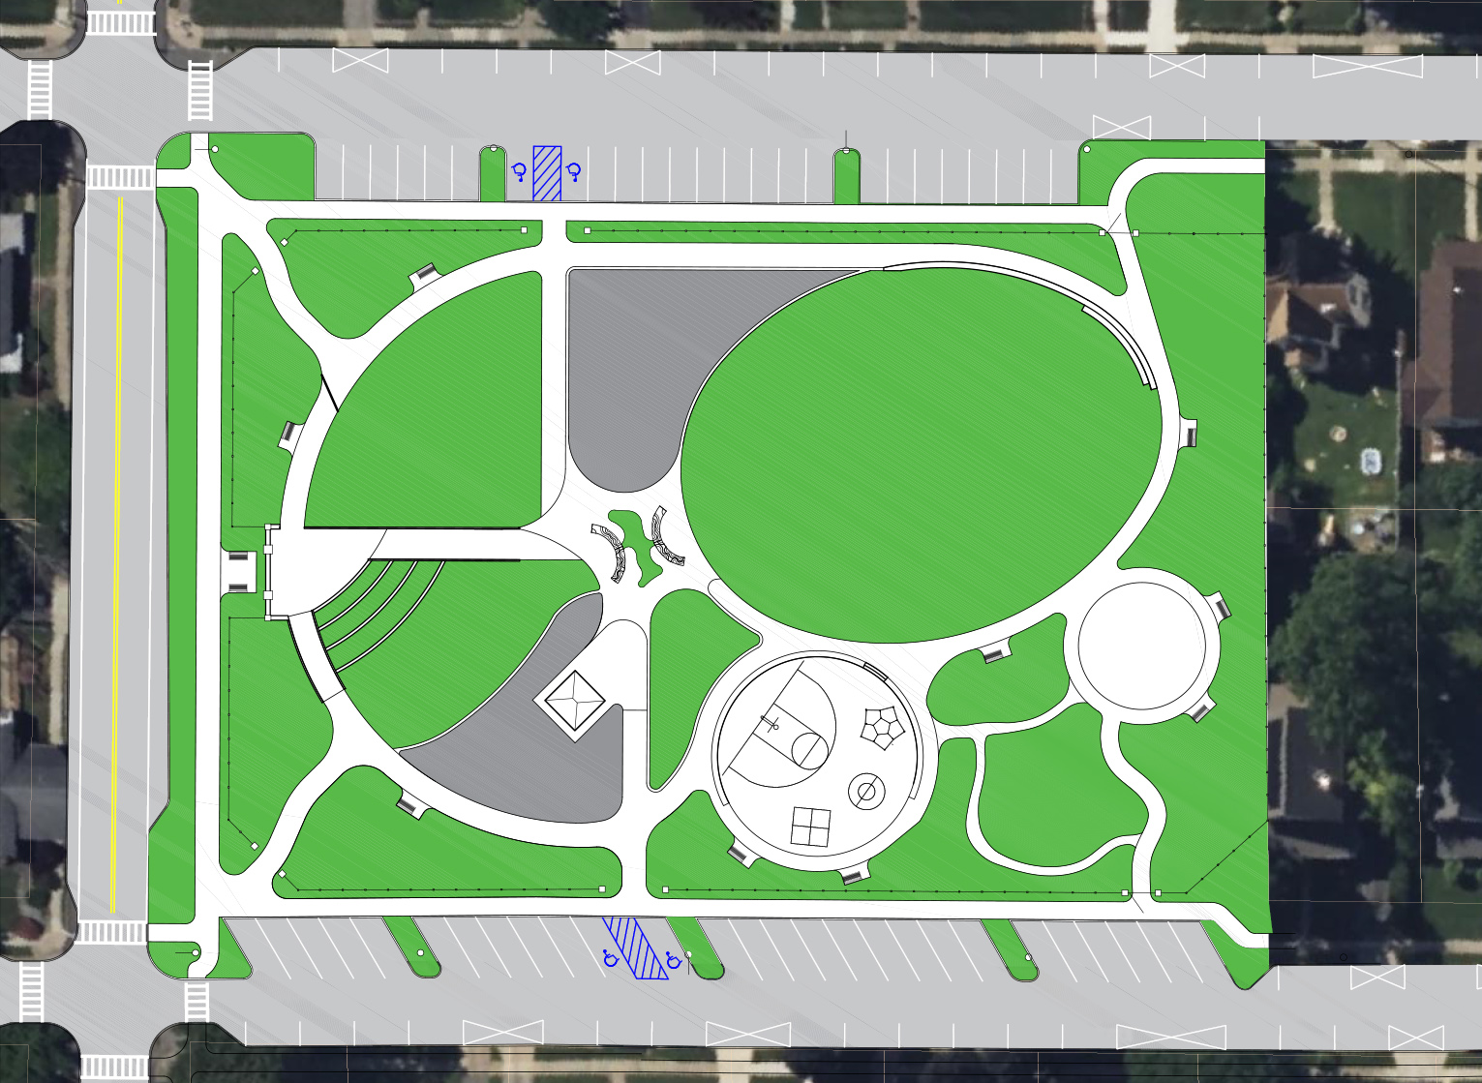
Parking – Proposed
    Sagamore along Park 27 Spaces
    Kenmore along Park 27 Spaces
    Total Spaces along Park 54 Spaces
    Sagamore Opposite Park 15 Spaces
    Kenmore Opposite Park 14 Spaces
    Total Spaces Opposite Park 29 Spaces
    Total Spaces
    within the
    Park Vicinity 83 Spaces
    Existing 65 Spaces
    Net Gain 18 Spaces
Sagamore Rd
Sagamore Rd
    Total Existing On-street Spaces within the Park Vicinity
    65 Spaces
    Total Proposed Spaces within the Park Vicinity
    83 Spaces
Earlington Rd
Earlington Rd
Kenmore Rd
Kenmore Rd

Slide 27
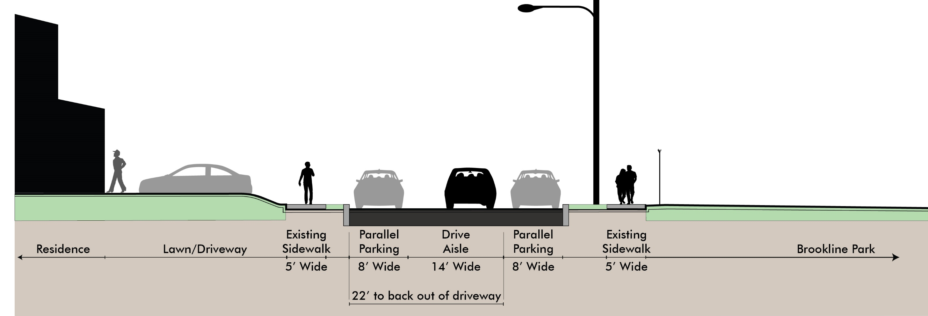
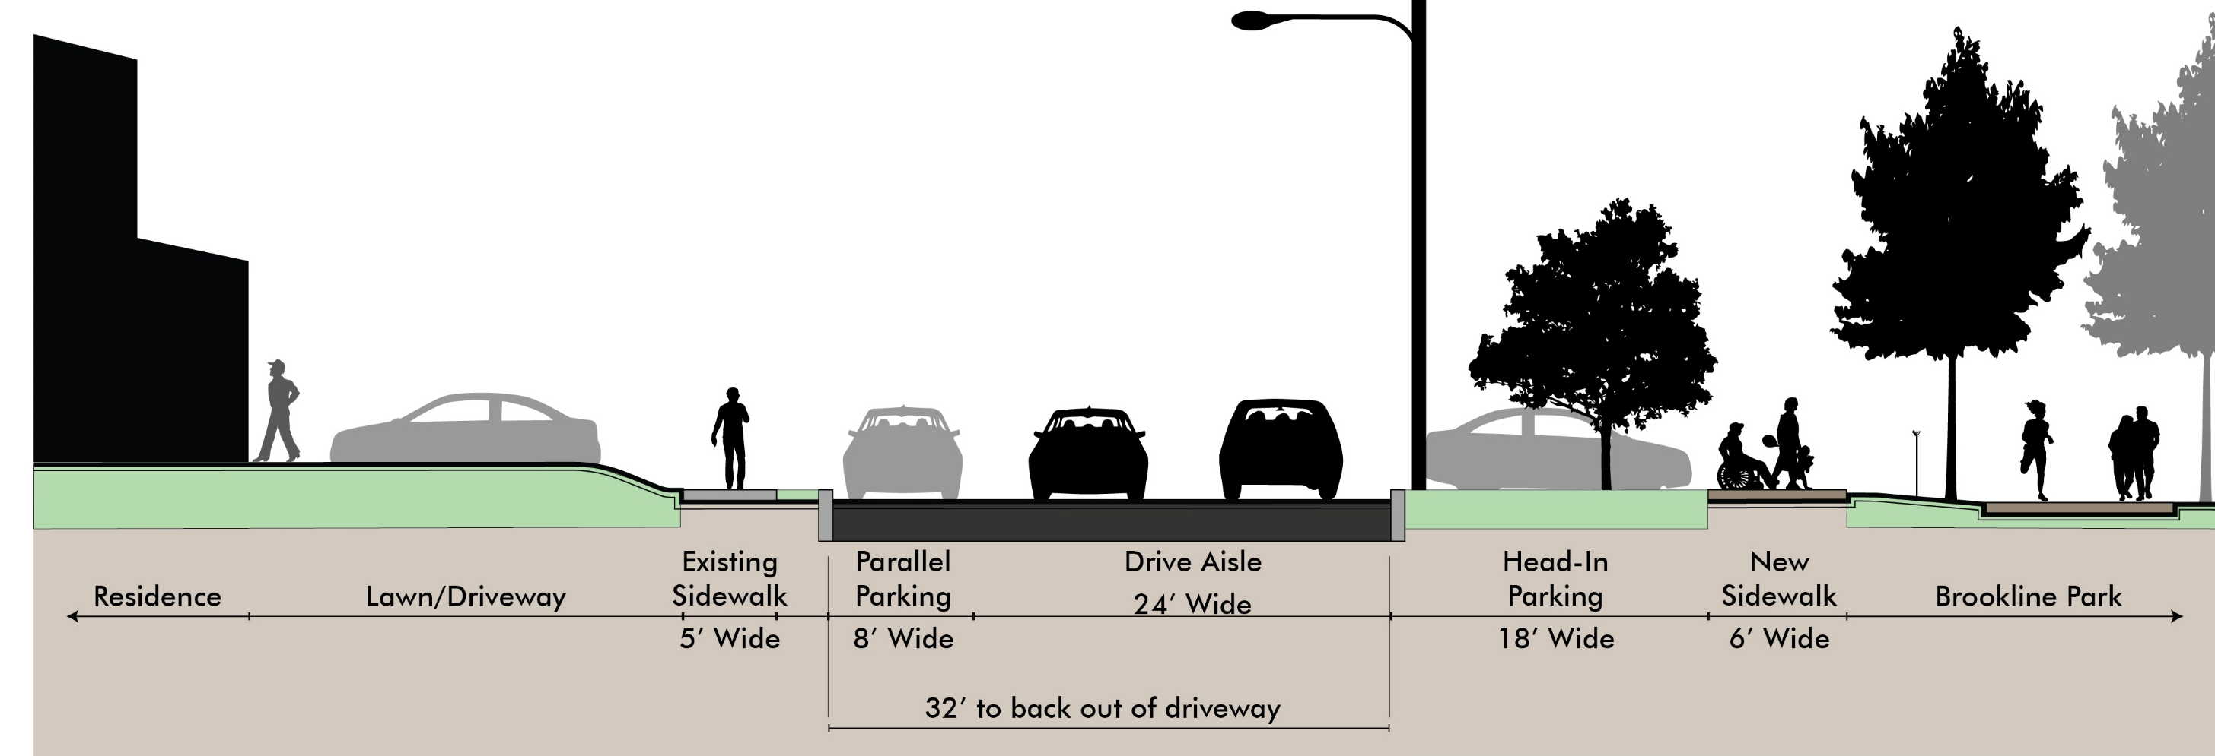
Parking – Section
Sagamore Road Existing Condition
14’ – wide Drive Aisle with Parking on Both Sides
Existing On-street Parking Both Sides
Existing Cartway 14’ wide.
Existing Park Entry / Transition Zone is Limited
Head-in Parking Added in Park
Existing On-street Parking remains on Residents side
Sagamore Road Proposed Condition
24’ – Wide Drive Aisle with Parking on Both Sides
Proposed Cartway 24’ wide.
Expanded Park Entry / Transition Zone
Proposed head in Street parking defined by curb extensions; new sidewalk, fencing, and tree plantings

Slide 28
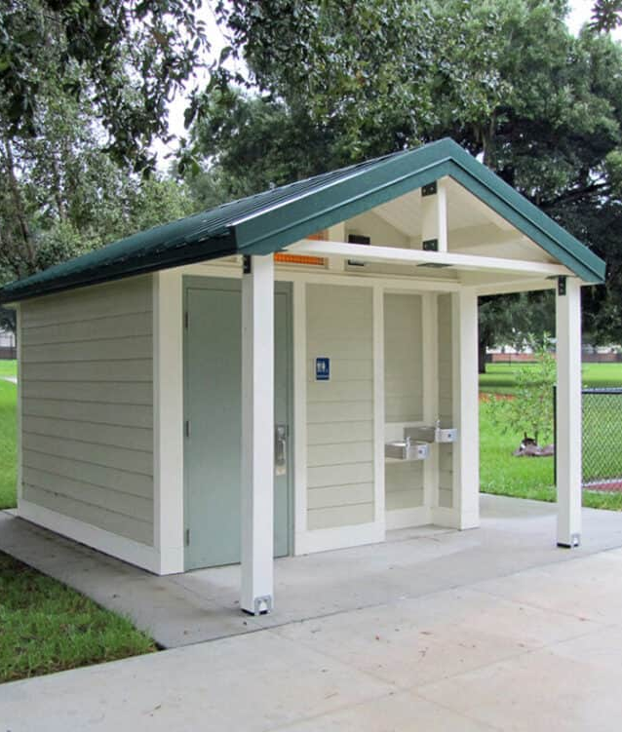
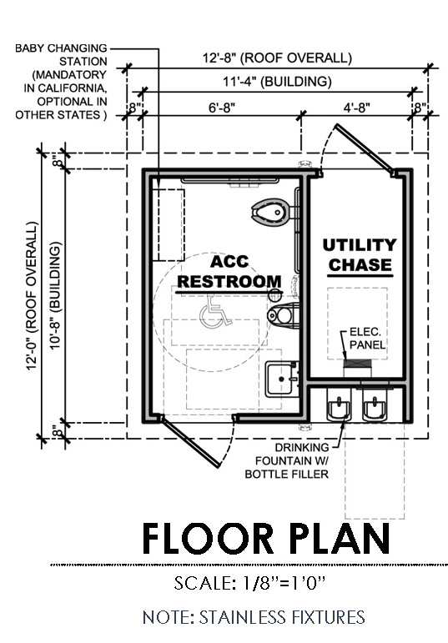
Single Occupancy Restroom
Drinking fountain
Vandal resistance finishes
    Wall mounted stainless steel fixtures
    Order minimizing floor finish
    Touchless fixtures
    Automatic nighttime locks
  Building design draw from the neighborhood’s residential architectural style
    Hip roof
    Shake shingle
    Stone work in façade

Slide 29
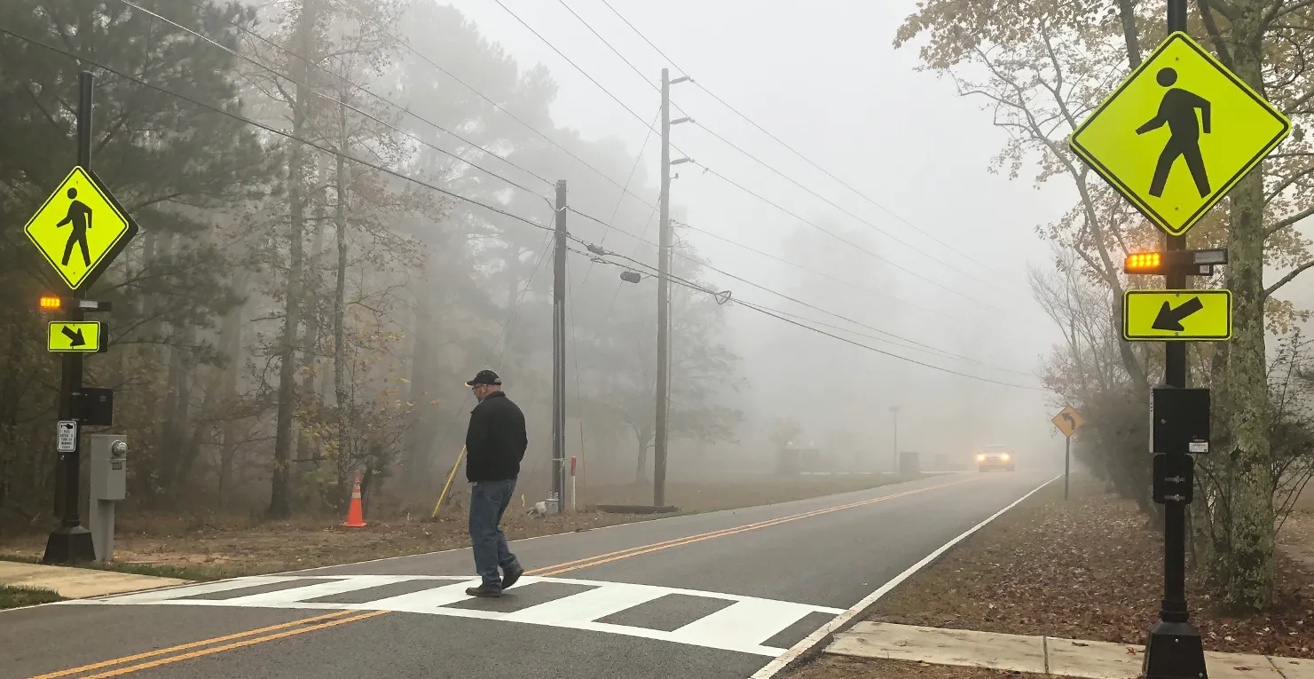
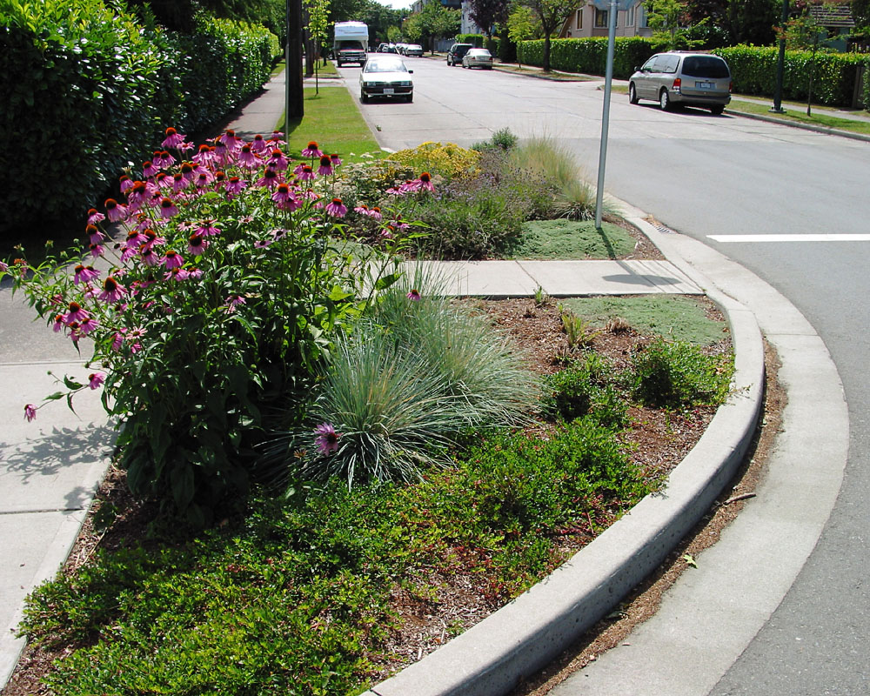
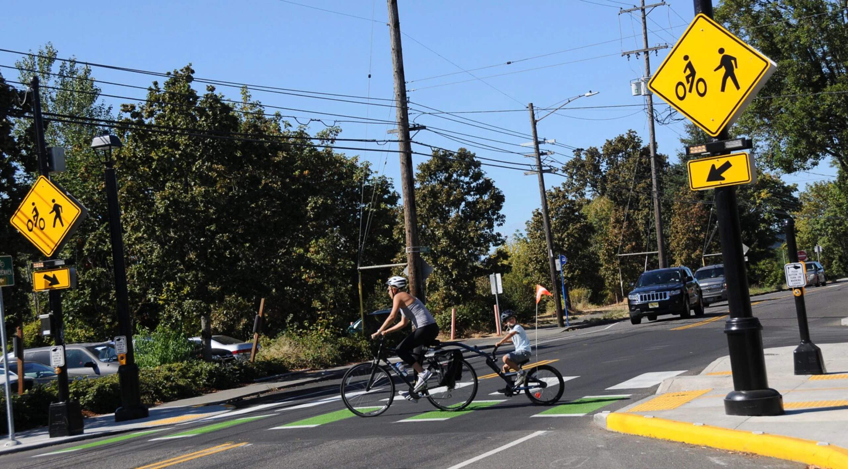
Earlington Road Traffic Calming
Safety & Traffic Calming Devices:
    Curb extension
    Crosswalks
    Rapid flashing beacon
    Street Trees
Final design will require PennDOT approval

Slide 30
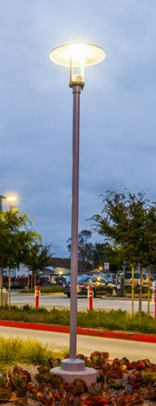
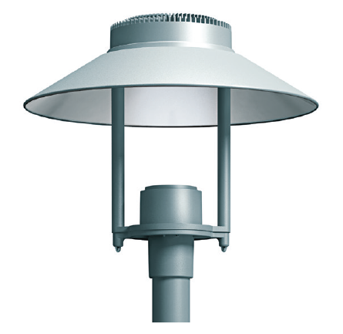
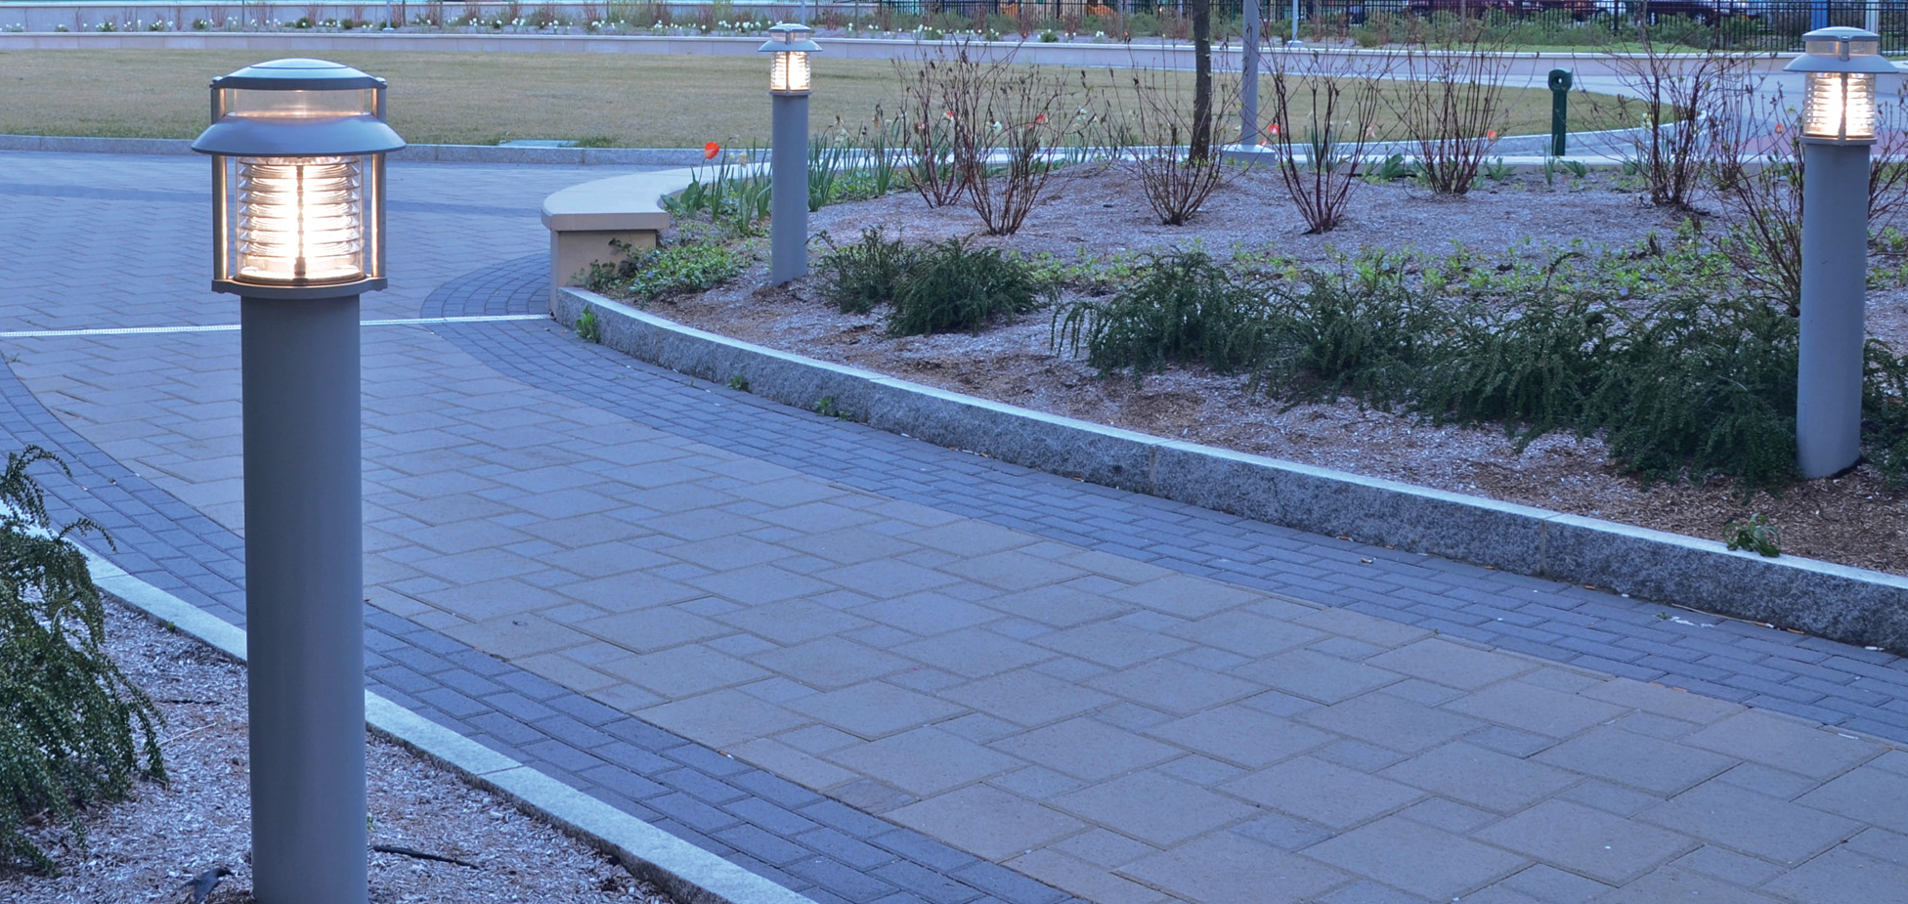
Lighting
Pathway lighting – standards & bollard options
Dark skies complaint
Directional controls along neighboring properties to control spill over lighting
Programable controls
Dim lights over night

Slide 31
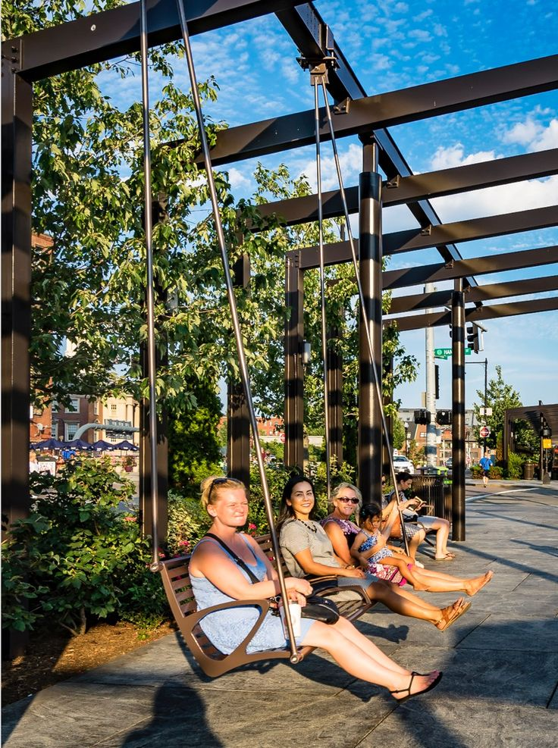
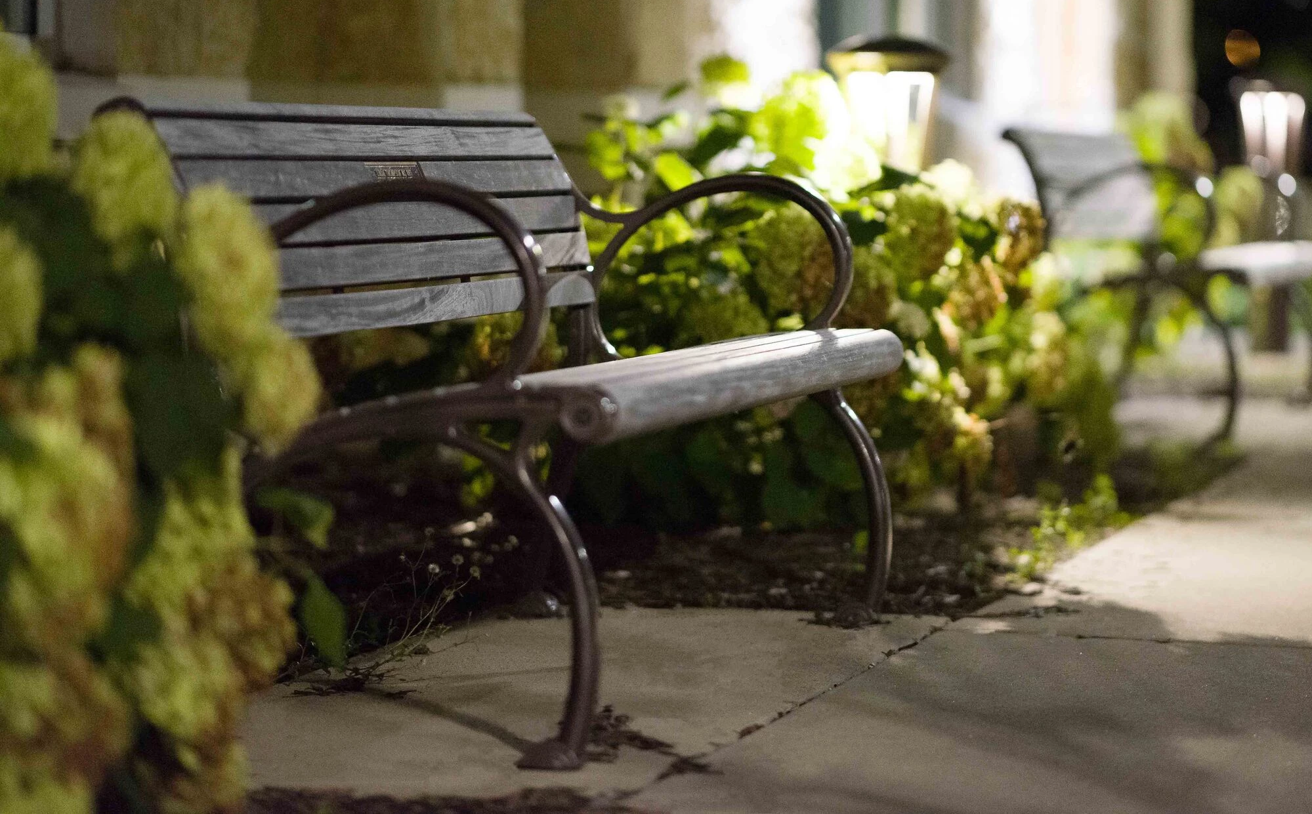
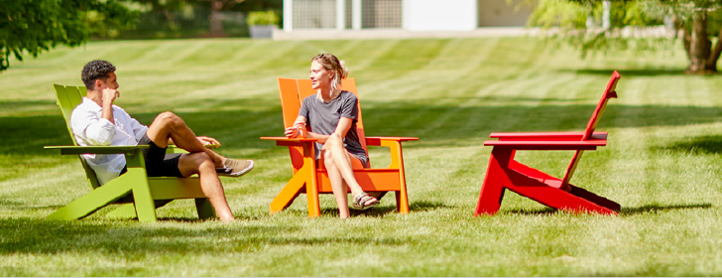
Porch Seating
Bench swing
Traditional benches
Movable Adirondack Style Chairs

Slide 32
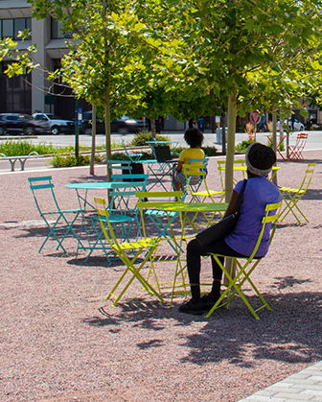
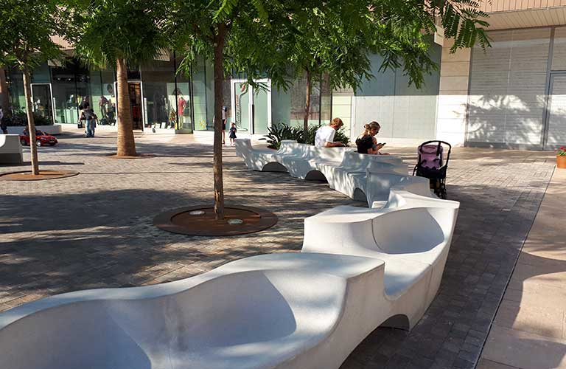
Seating
Movable bistro chairs & tables
Modern conversation bench (2)

Slide 33
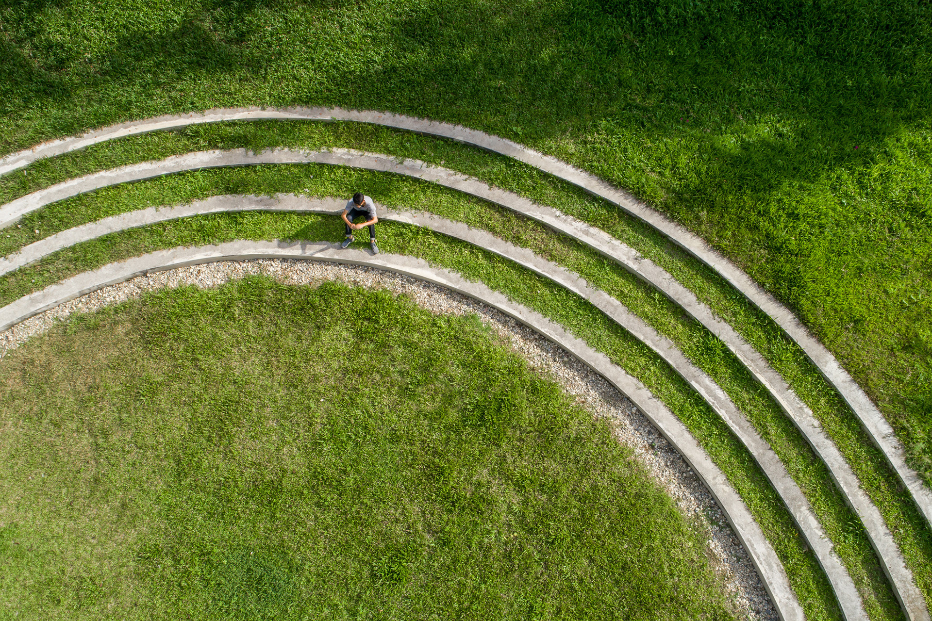
Elevated Plaza &Tiered Lawn Seating
Plaza elevated 2.5 feet
Tiered lawn defines transition between plaza and open lawn
Serve as informal seating for small groups

Slide 34
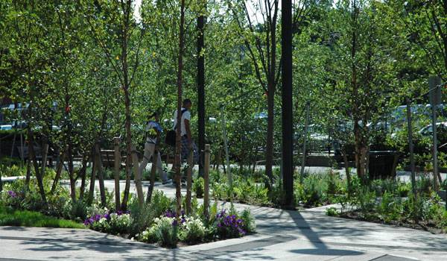
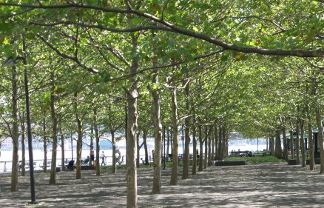
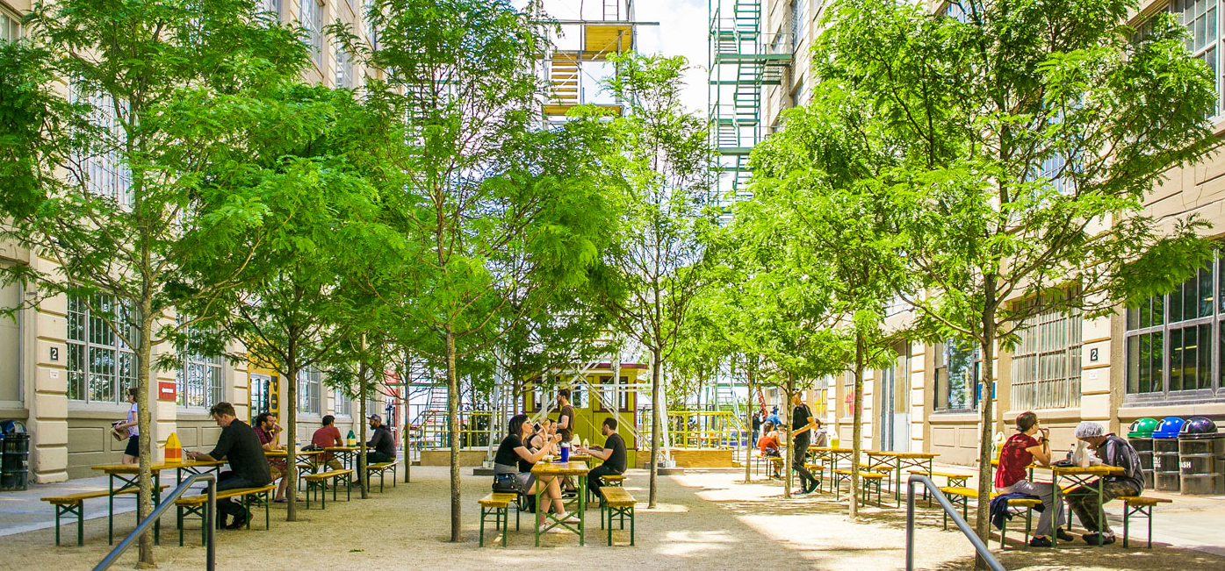
Tree Grove
Trees planted on grid
Focused Shade
Permeable stone dust paving provides opportunity to collect stormwater subsurface

Slide 35
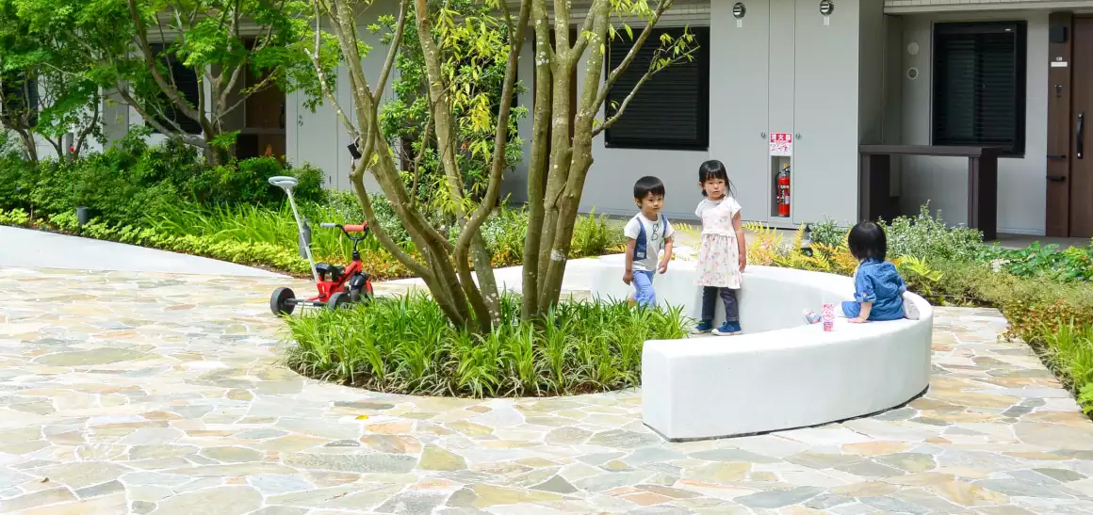
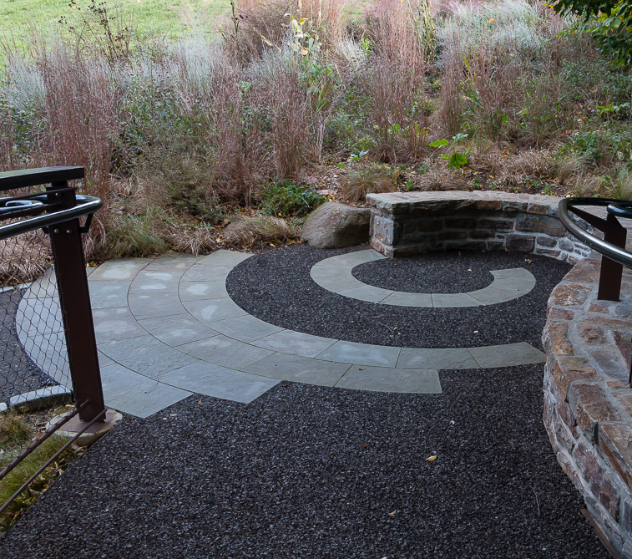
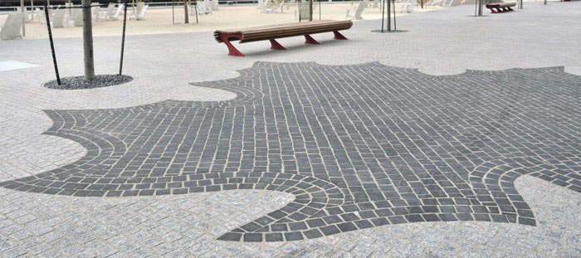
Central Plaza Paving
Natural Stone Material
Organic Pattern

Slide 36
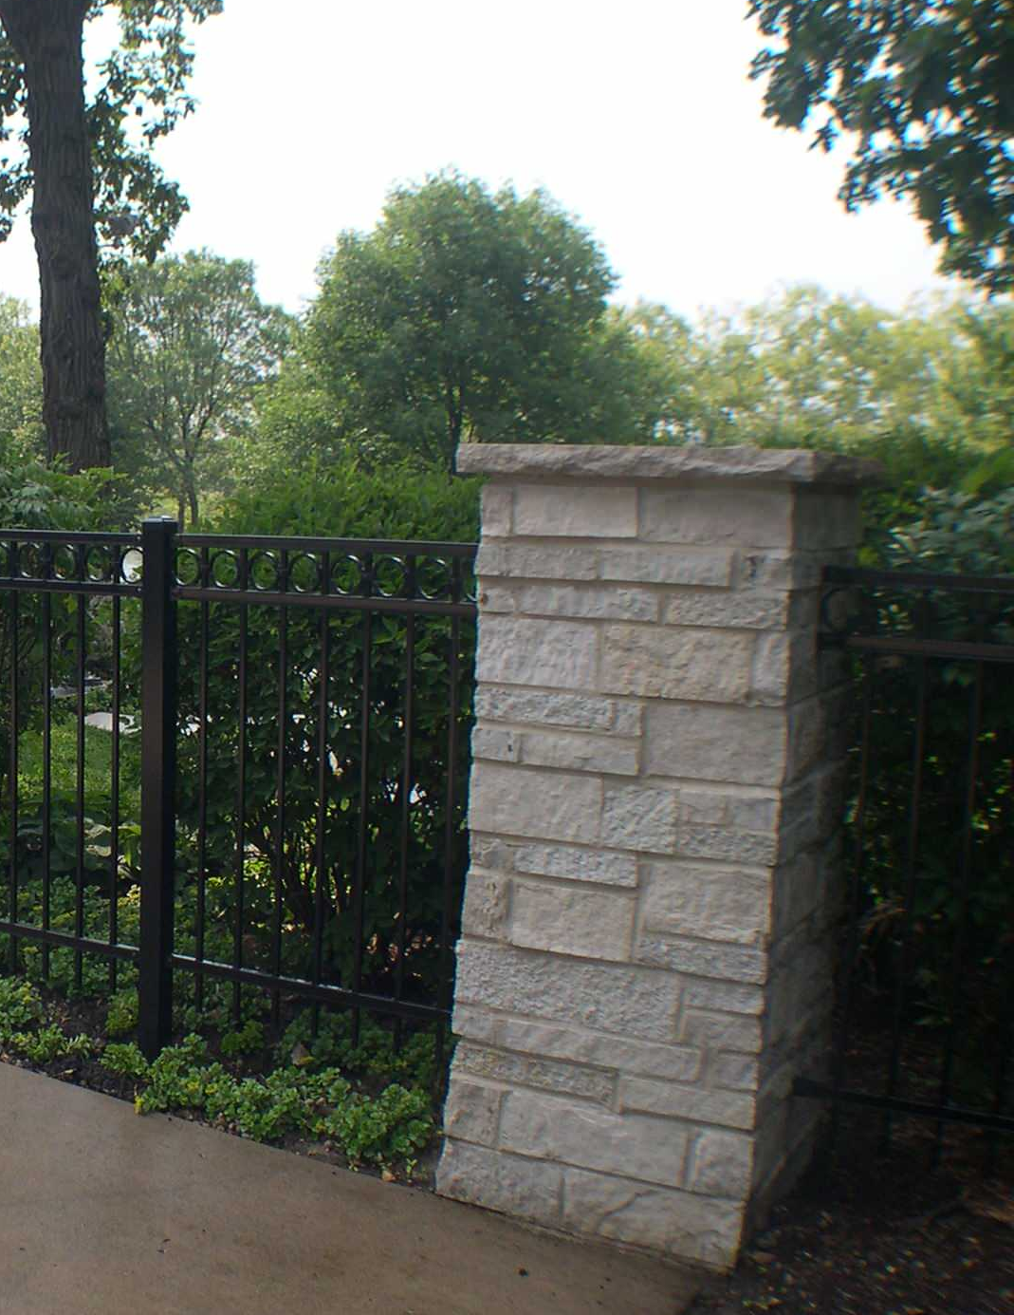
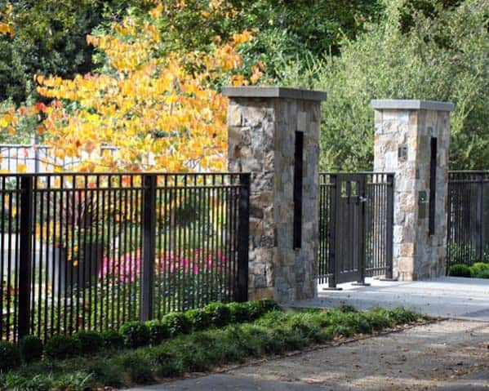
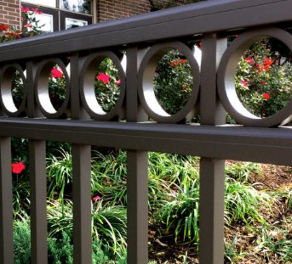
Fencing
Decorative metal perimeter fencing
Simple detail / non-black powder coat color such as bronze
4 feet height
Use salvaged stone to create stone piers denoting entrances

Slide 37
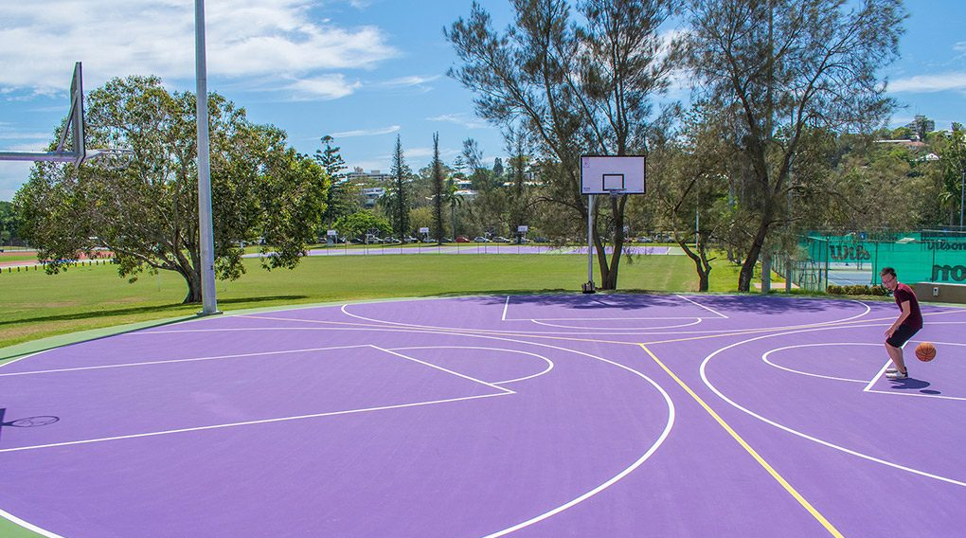
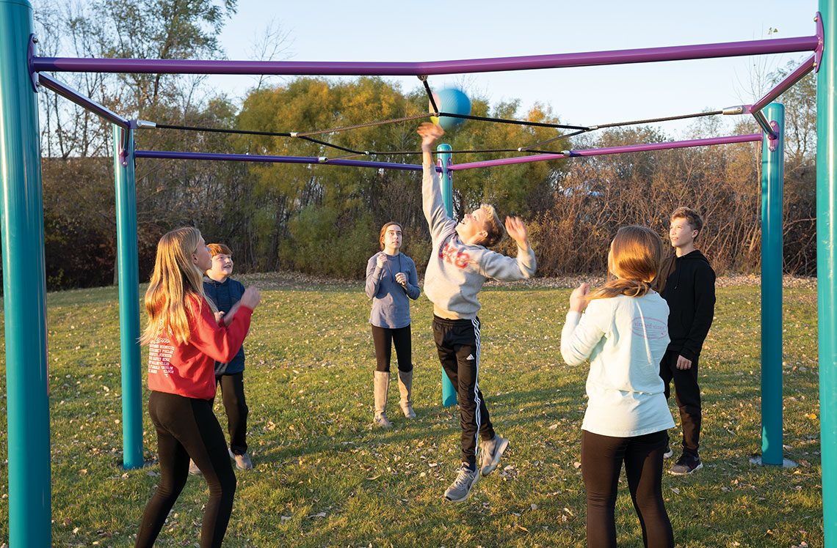
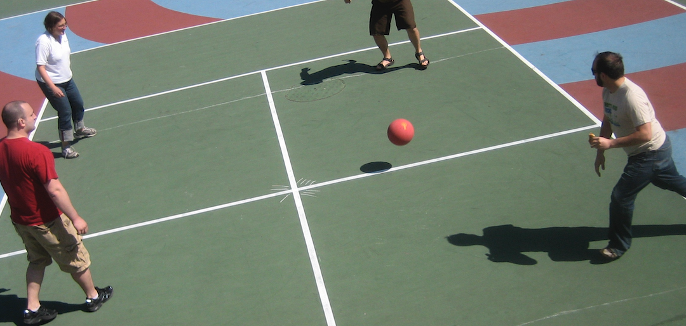
Court Game Area
Single half court basketball
Four square
Over head play
Open chalk play

Slide 38
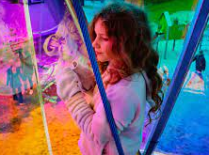
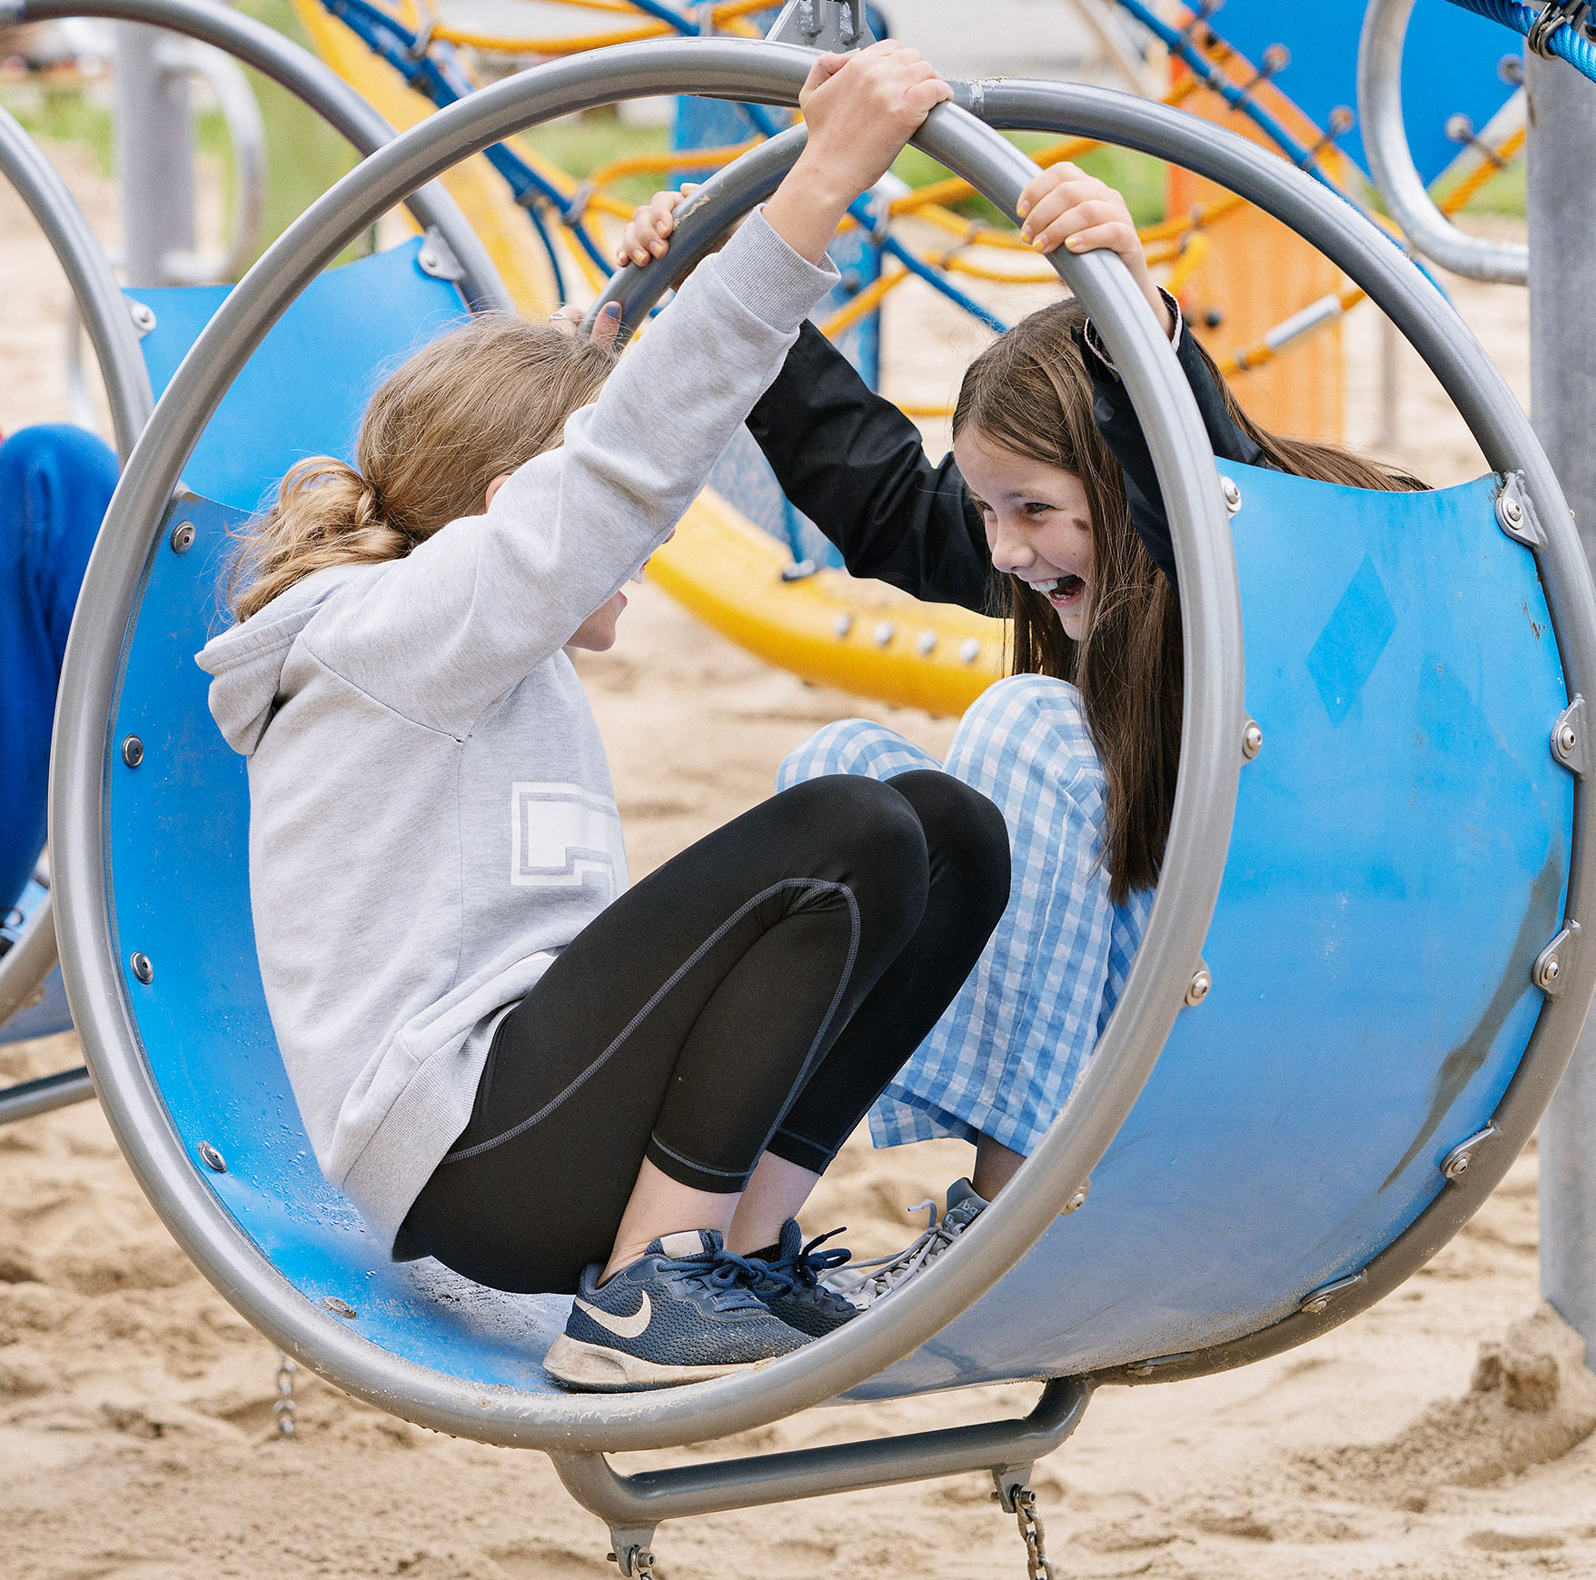
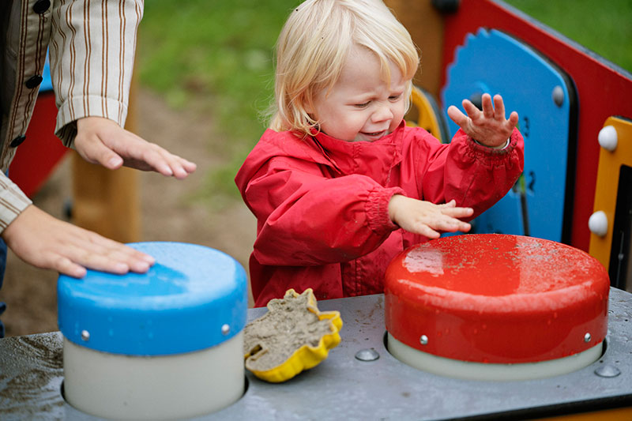



Playground Area
Playground structure
Lawn play mounds
Children's garden discovery paths

Slide 39



Open Lawn
Informal pick up games
Sized for youngest level soccer and tee ball
Neighborhood / Penfield Civic events such as movie night in the park

Slide 40
Concept Alternative Studies
4 Concepts were presented to the Committee and Public for comment and feedback
Concept A
Concept B
Concept C
Concept D

Slide 41
Project Schedule
BROOKLINE PARK MEETINGS | PURPOSE | DATE | TIME
Steering Committee Meeting 1 | Project review, protocols | Wed, Sep 28, 2022 | 7:00 PM - 8:30 PM
Steering Committee Meeting 2 | Site Visit / Brainstorming | Wed, Oct 19, 2022 | 5:00 PM – 7:00 PM
Public Meeting 1 | Brainstorming | Mon, Oct 24, 2022 | 7:00 PM - 9:00 PM
Focus Group Meeting 1 | Focus Group TDB | Wed, Nov 9, 2022 | 5:30 PM - 7:00 PM
Focus Group Meeting 2 | Focus Group TDB | Wed, Nov 9, 2022 | 7:30 PM - 9:00 PM
Focus Group Meeting 3 | Middle School Students | Thurs, Nov 10, 2022 | TBD
Focus Group Meeting 4 | Penfield Civic | Wed, Nov 16, 2022 | 5:30 - 6:30 PM
Focus Group Meeting 4 | Focus Group TDB | Thurs, Nov 10, 2022 | 7:30 PM - 9:00 PM
Steering Committee Meeting 3 | Initial Concepts | Wed, Nov 16, 2022 | 7:00 PM - 8:30 PM
Public Meeting 2 | Initial Concepts | Tues, Dec 6, 2022 | 7:00 PM - 9:00 PM
Steering Committee Meeting 4 | Concepts Refinement | Tues, Jan 24, 2023 | 7:00 PM - 8:30 PM
Steering Committee Meeting 5 | Pre-Draft Master Plan | Tues, Mar 7, 2023 | 7:00 PM - 8:30 PM
Public Meeting 3 | Draft Master Plan | Wed, Mar 29, 2023 | 7:00 PM - 9:00 PM
Board of Commissioners | Draft Master Plan | Mon, April 10, 2023
Steering Committee Meeting 6 | Review Draft Plan comments | Tue, June 6, 2023 | 7:00 PM - 8:30 PM
Public Meeting 4 | Final Master Plan | Thu, June 29, 2023 | 7:00 PM - 9:00 PM
Board of Commissioners Meeting 2 | Final Master Plan | Mon, July 10, 2023

Slide 42
Next Steps
Brookline Park Master Plan

